Slide 1
Partial Volume Correction
Suzanne Baker

Slide 2

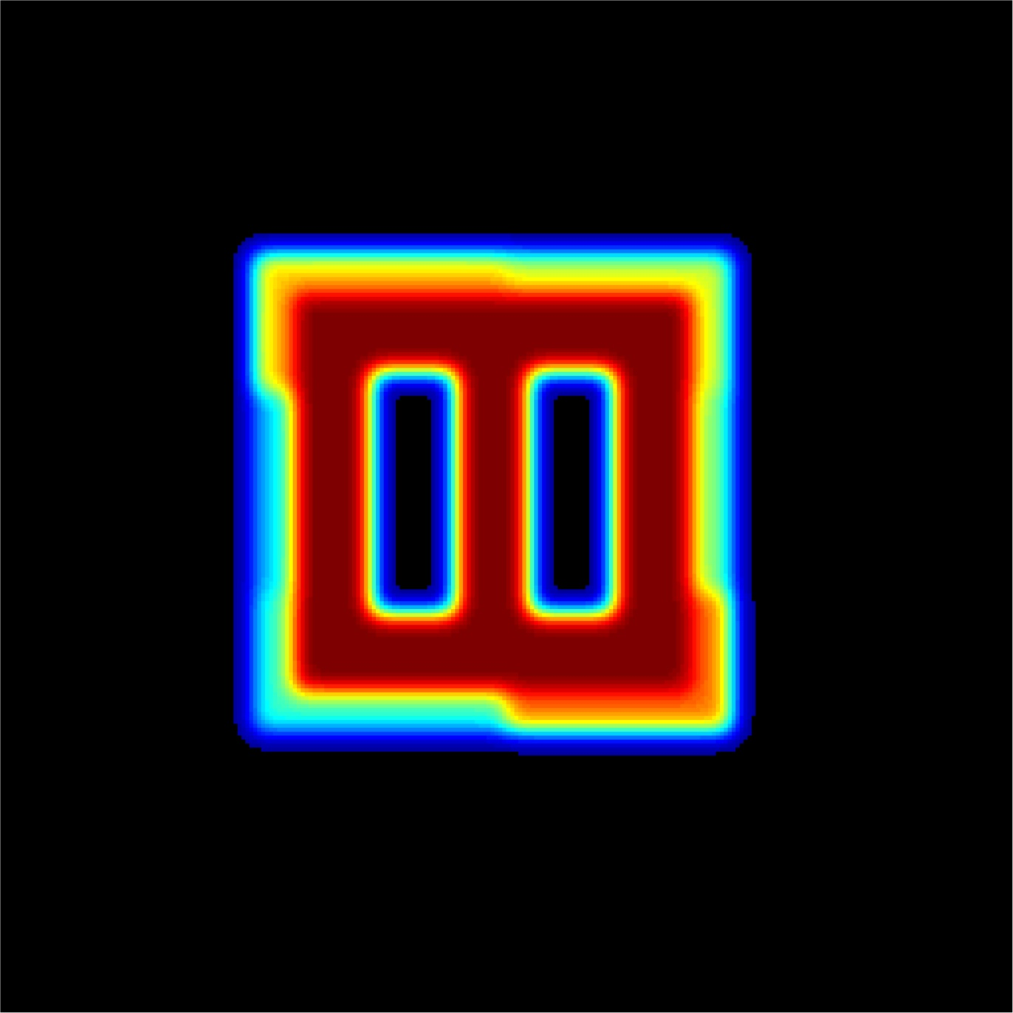
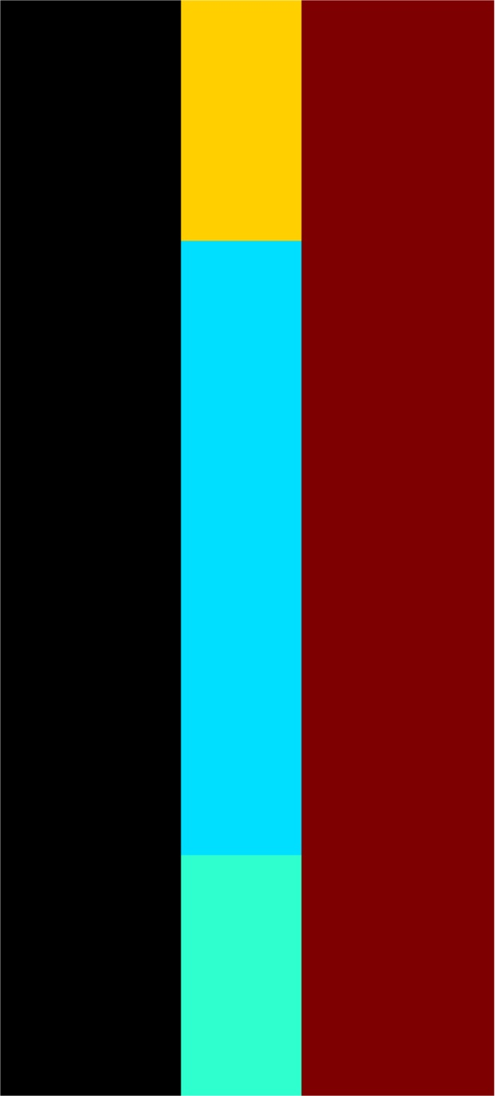

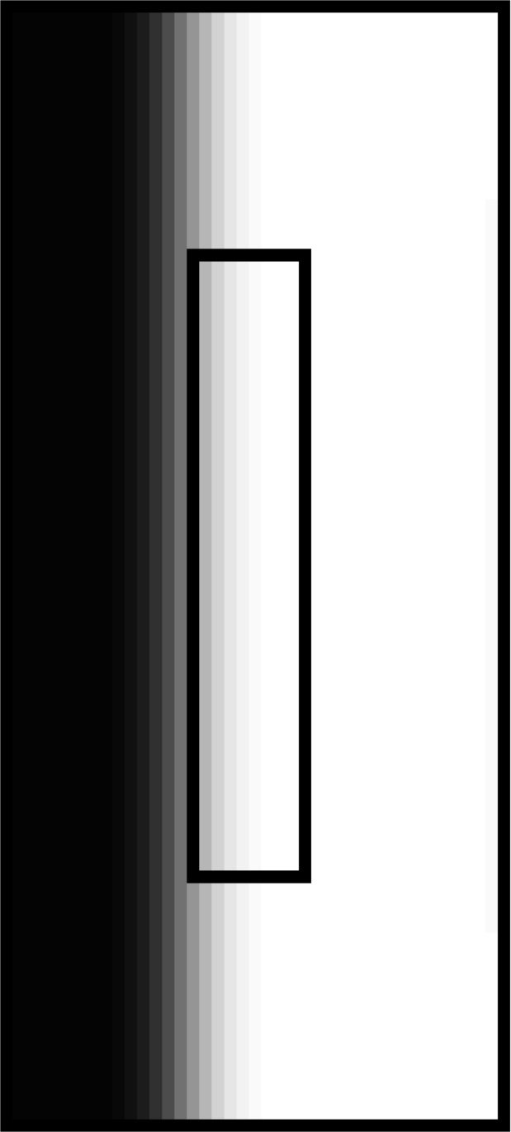

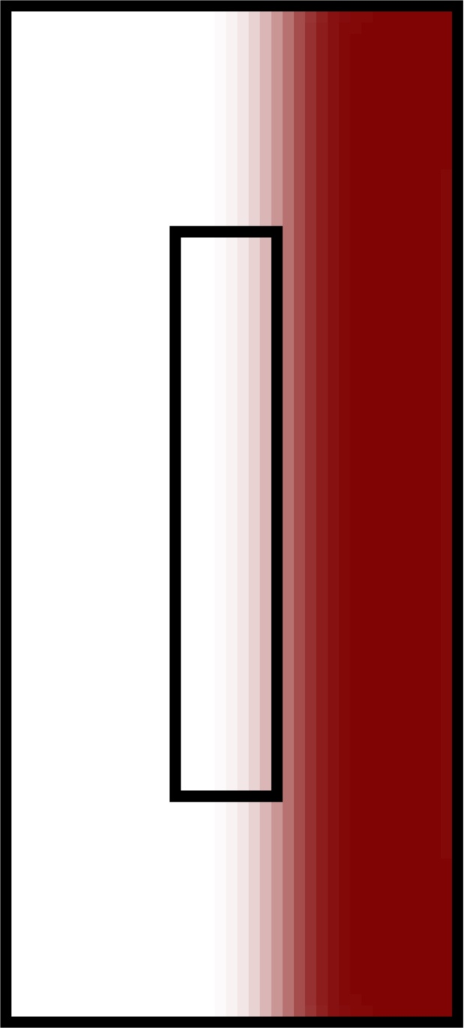
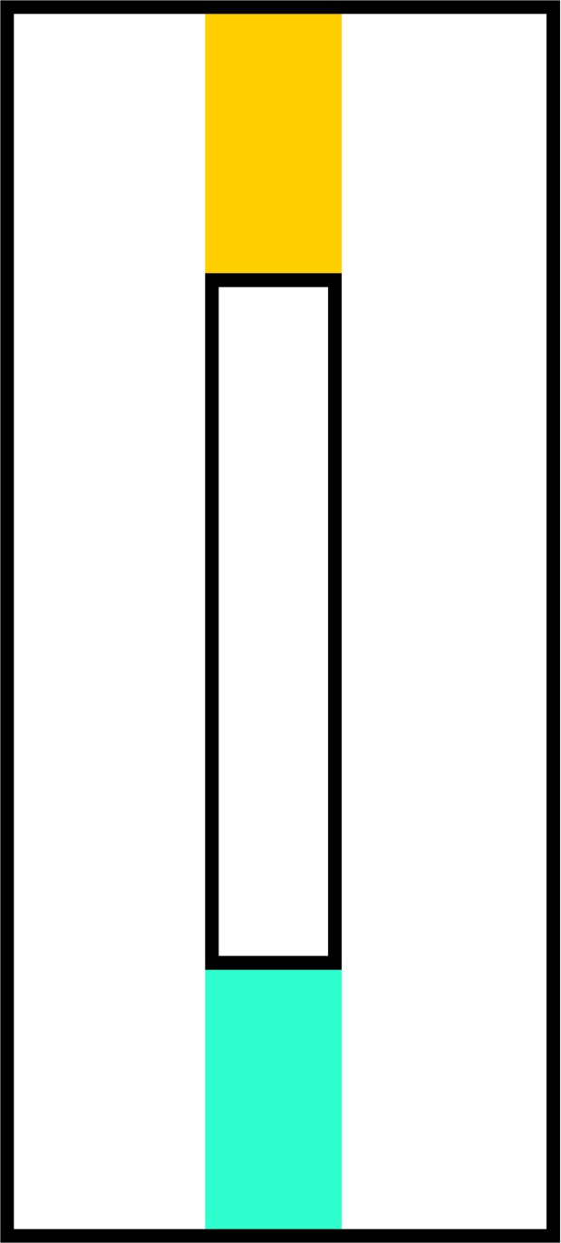
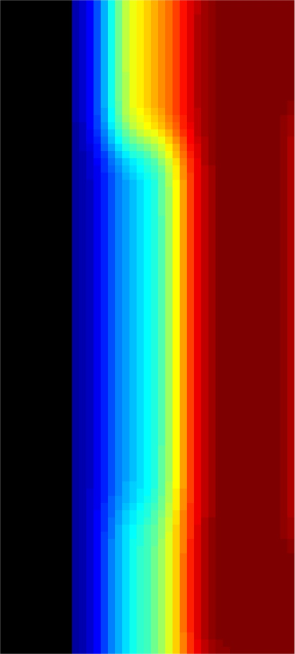
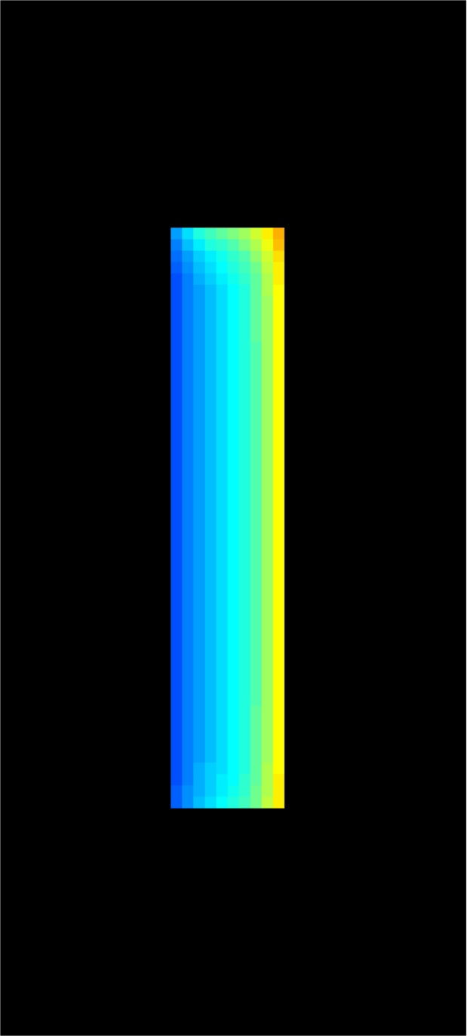
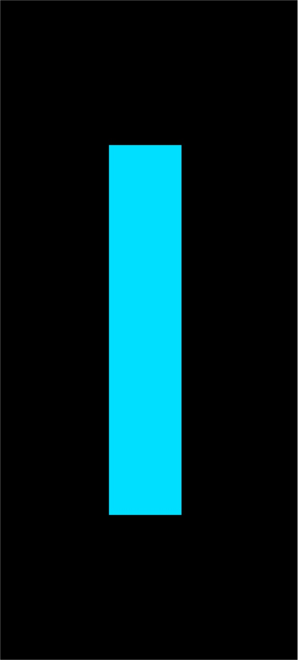
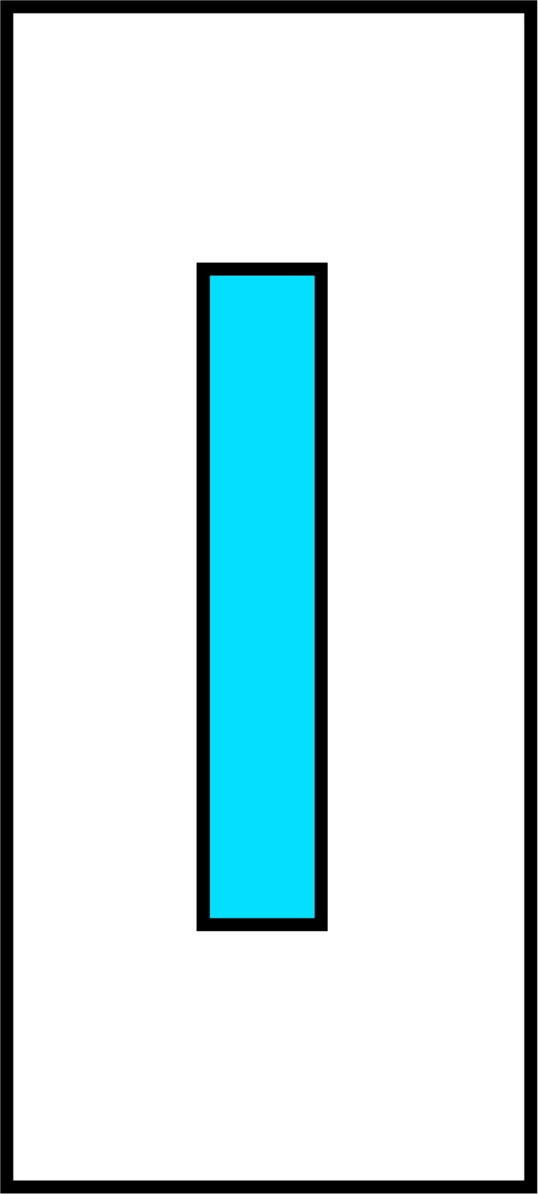
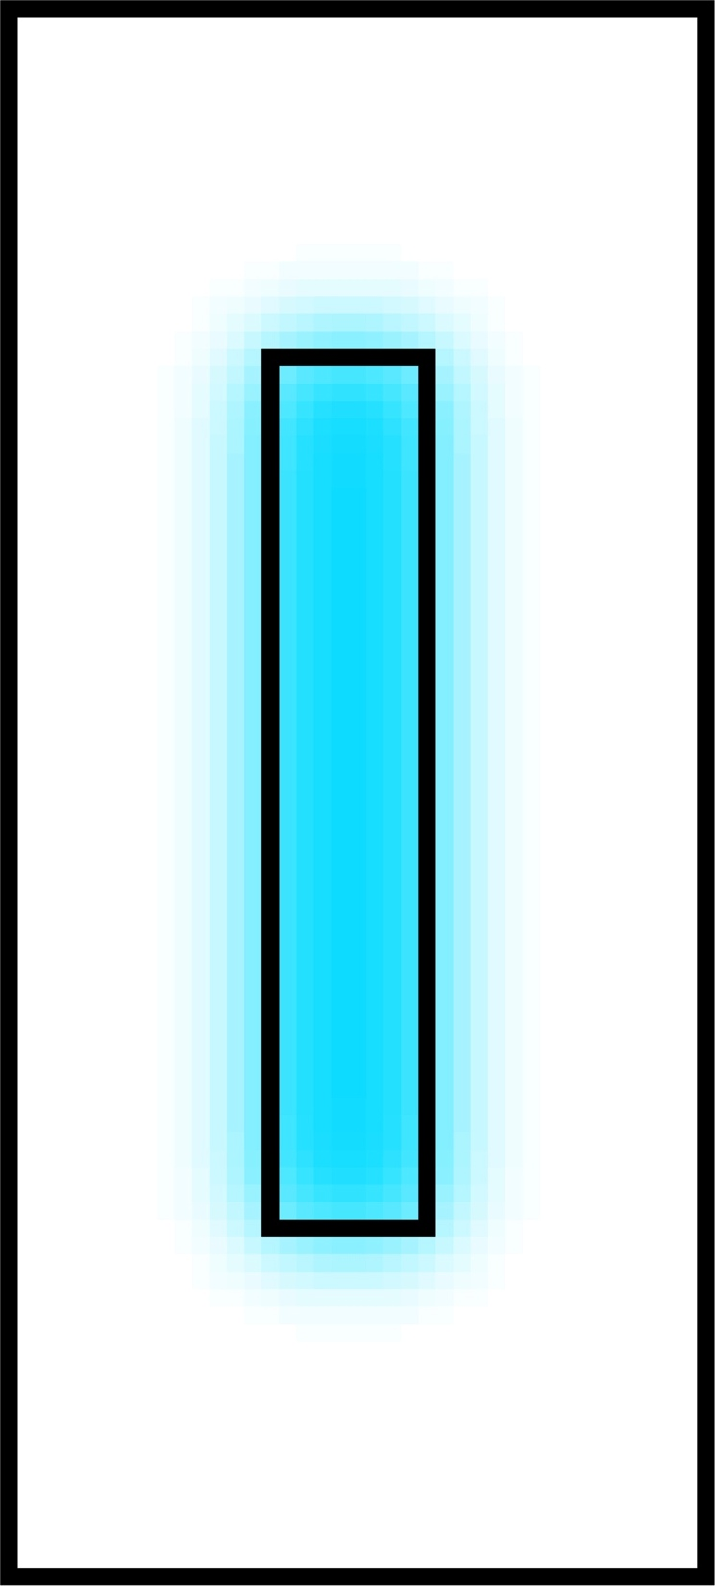
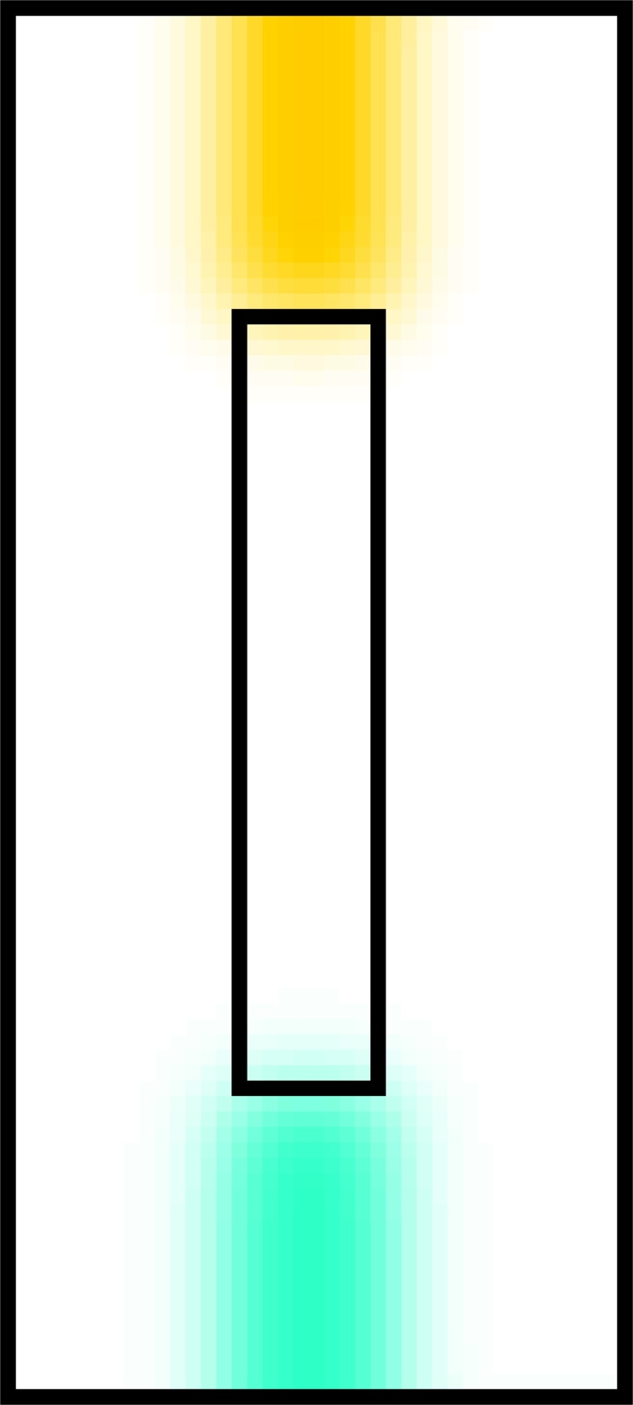
What is this Partial Volume Issue???
Square Brain

Slide 3
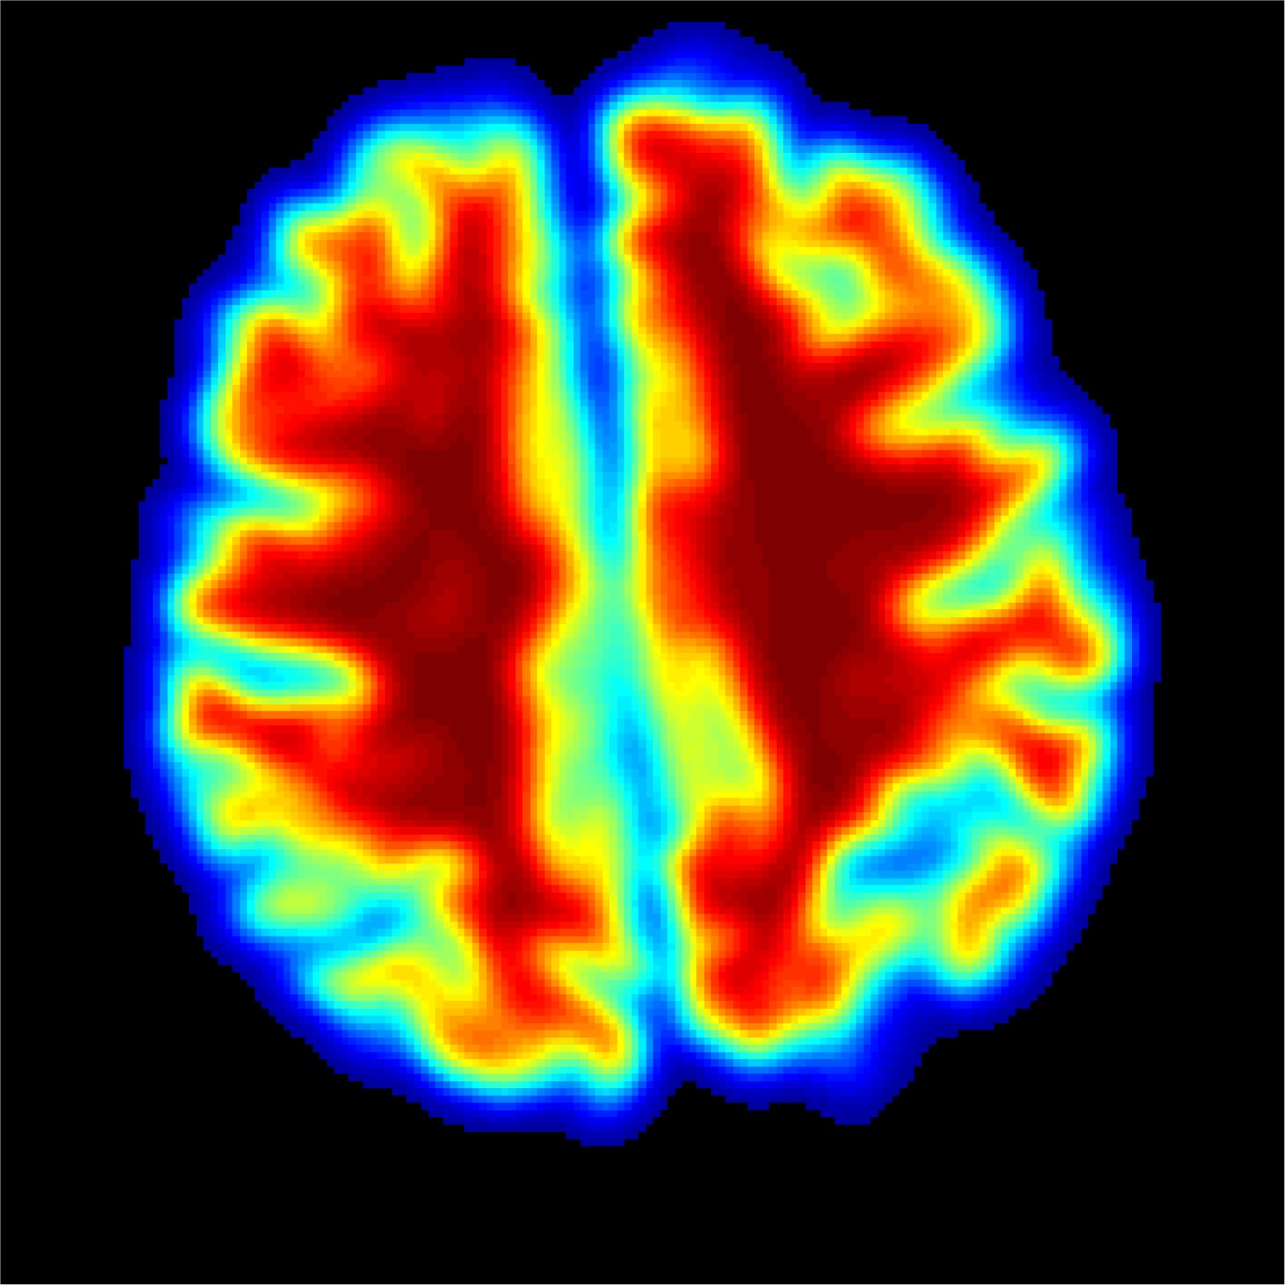
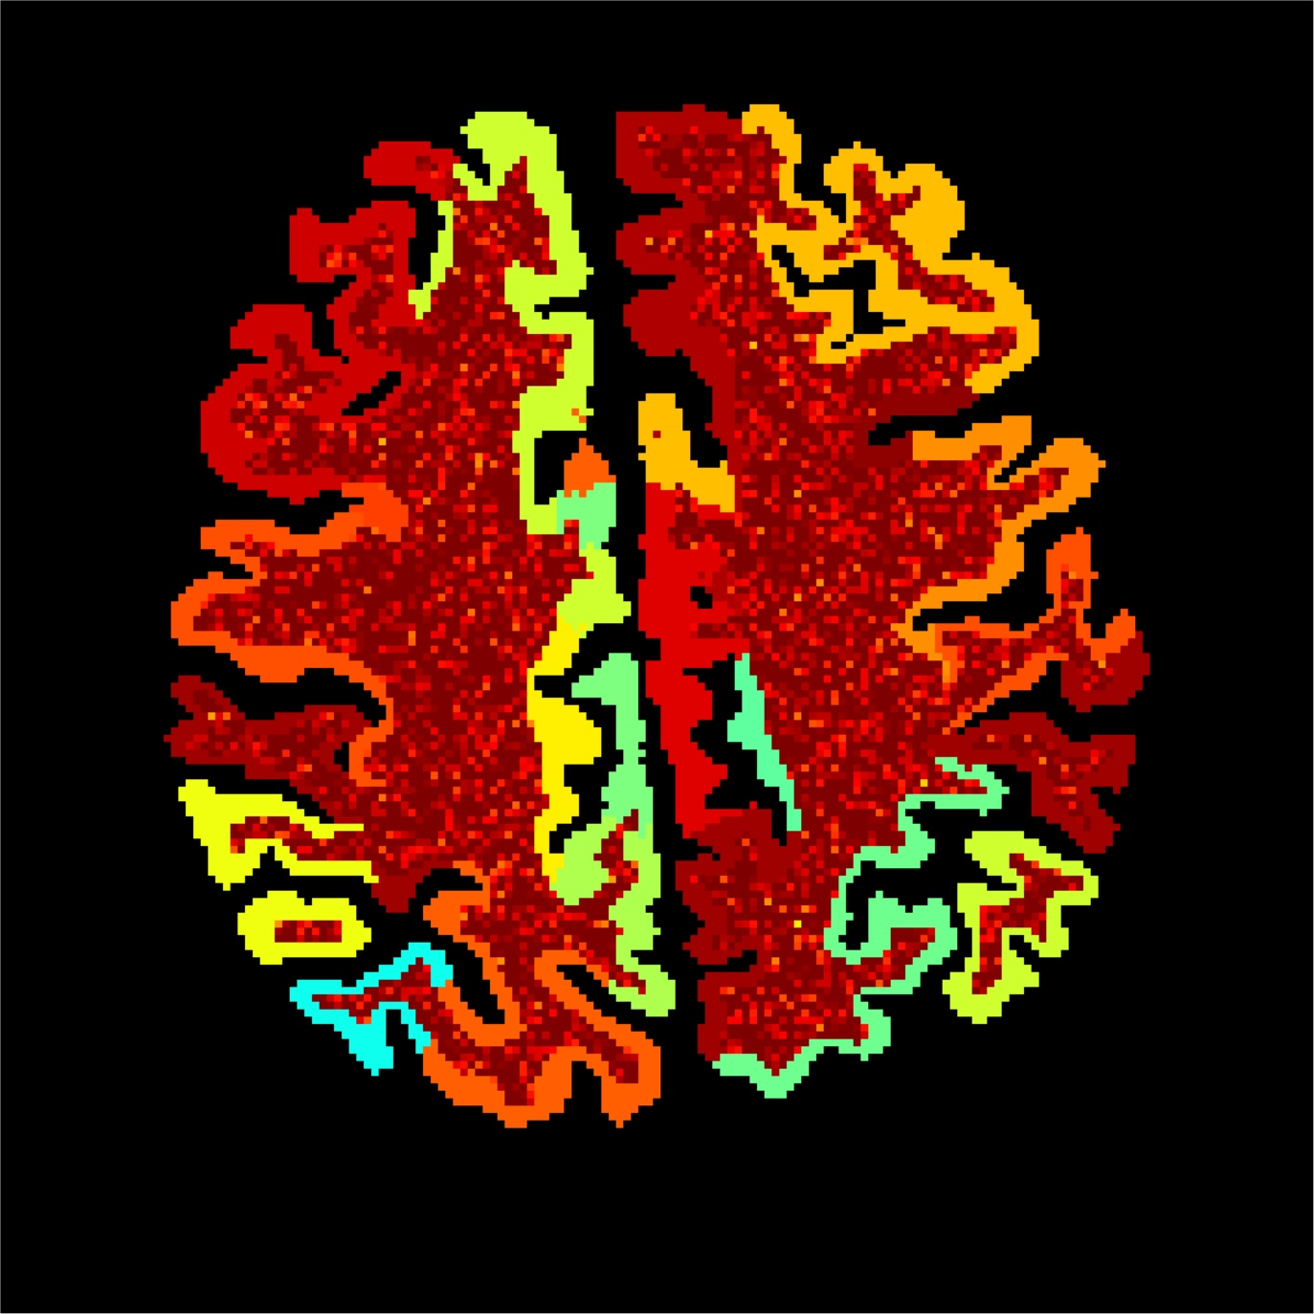
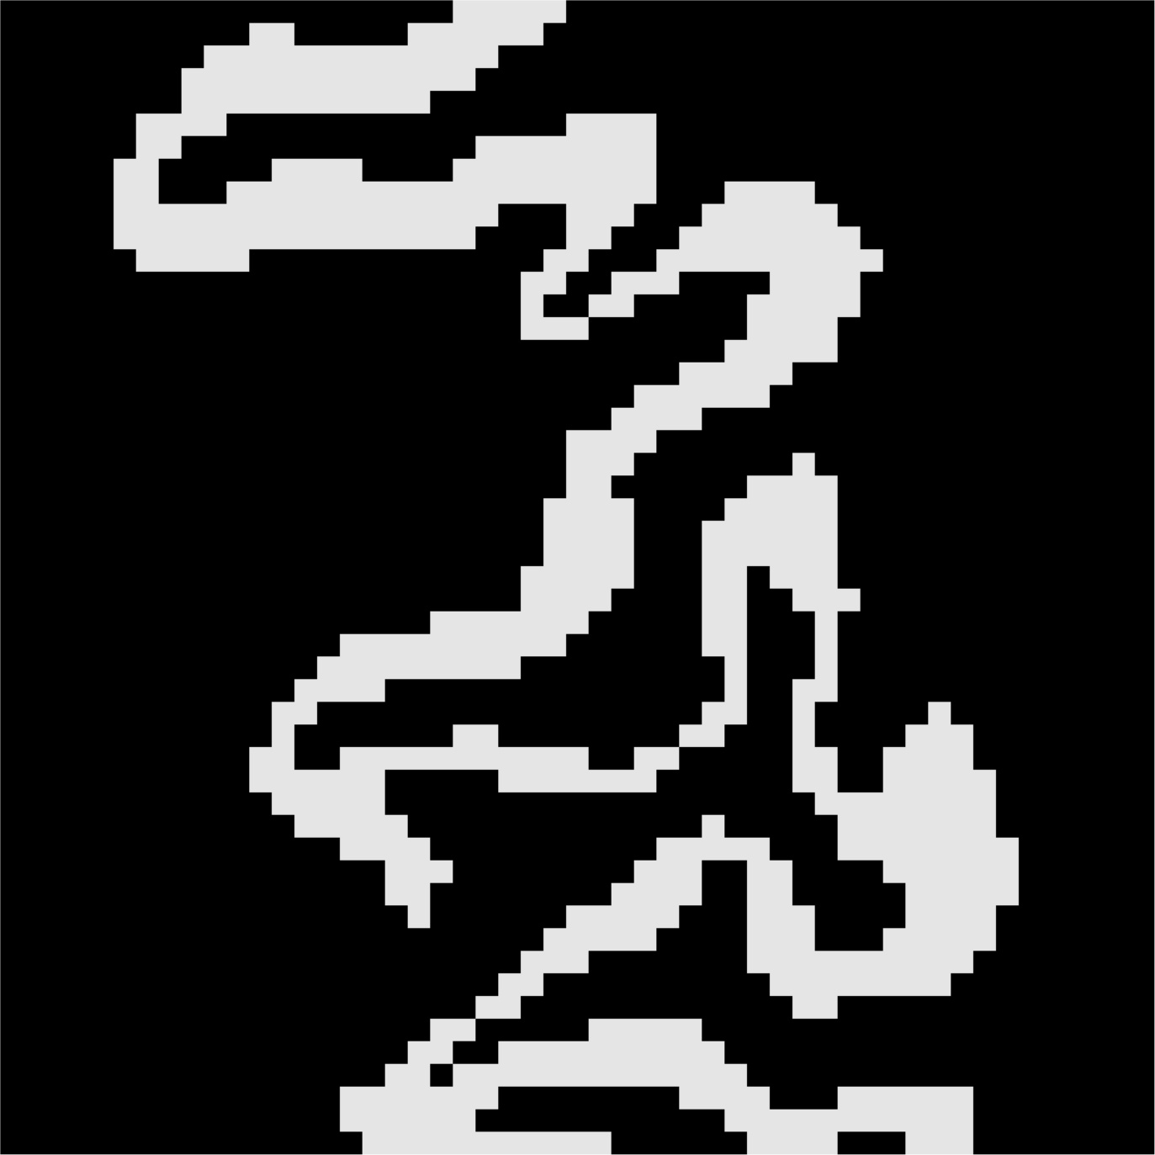
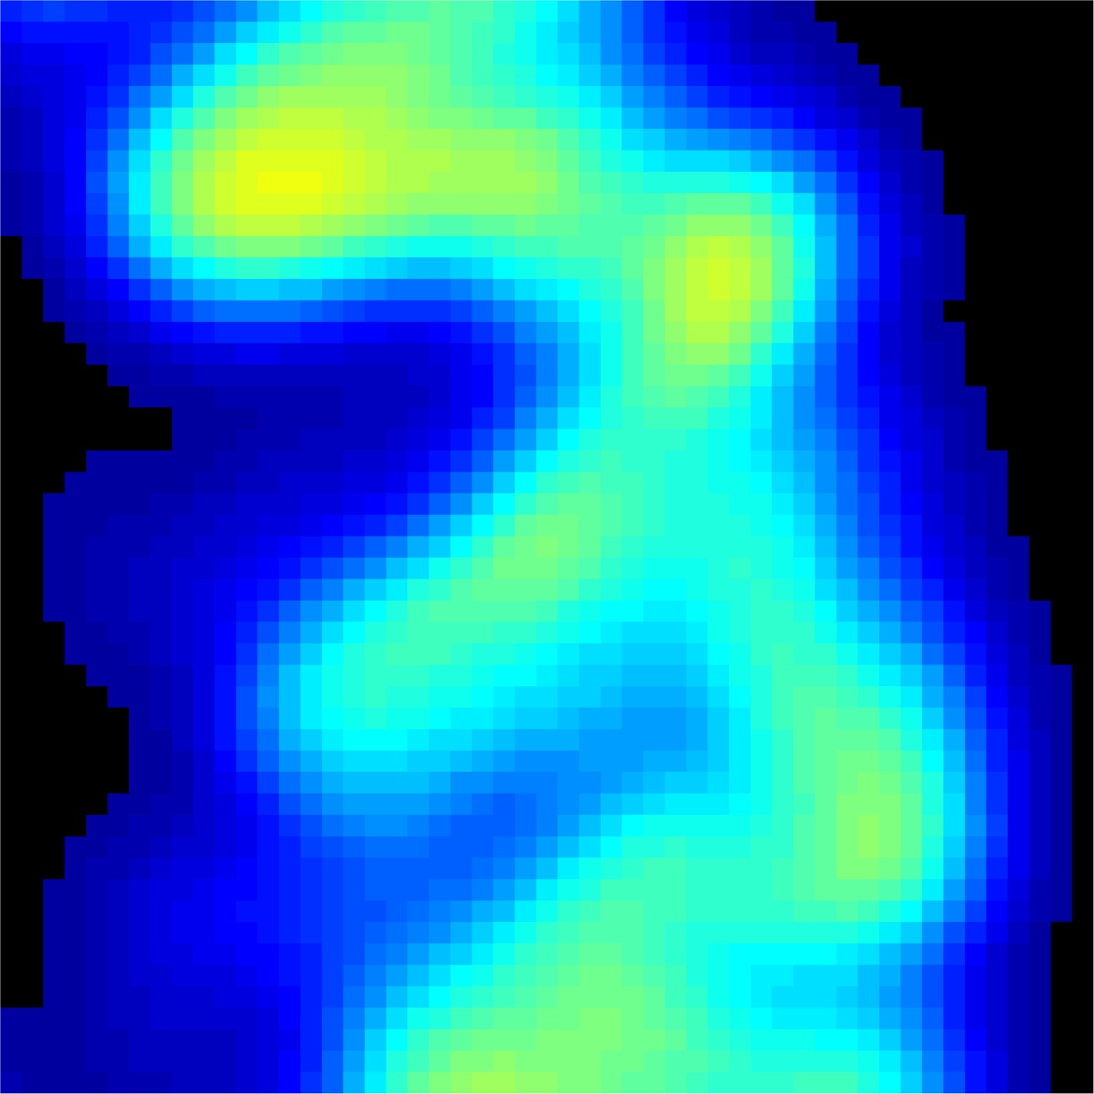
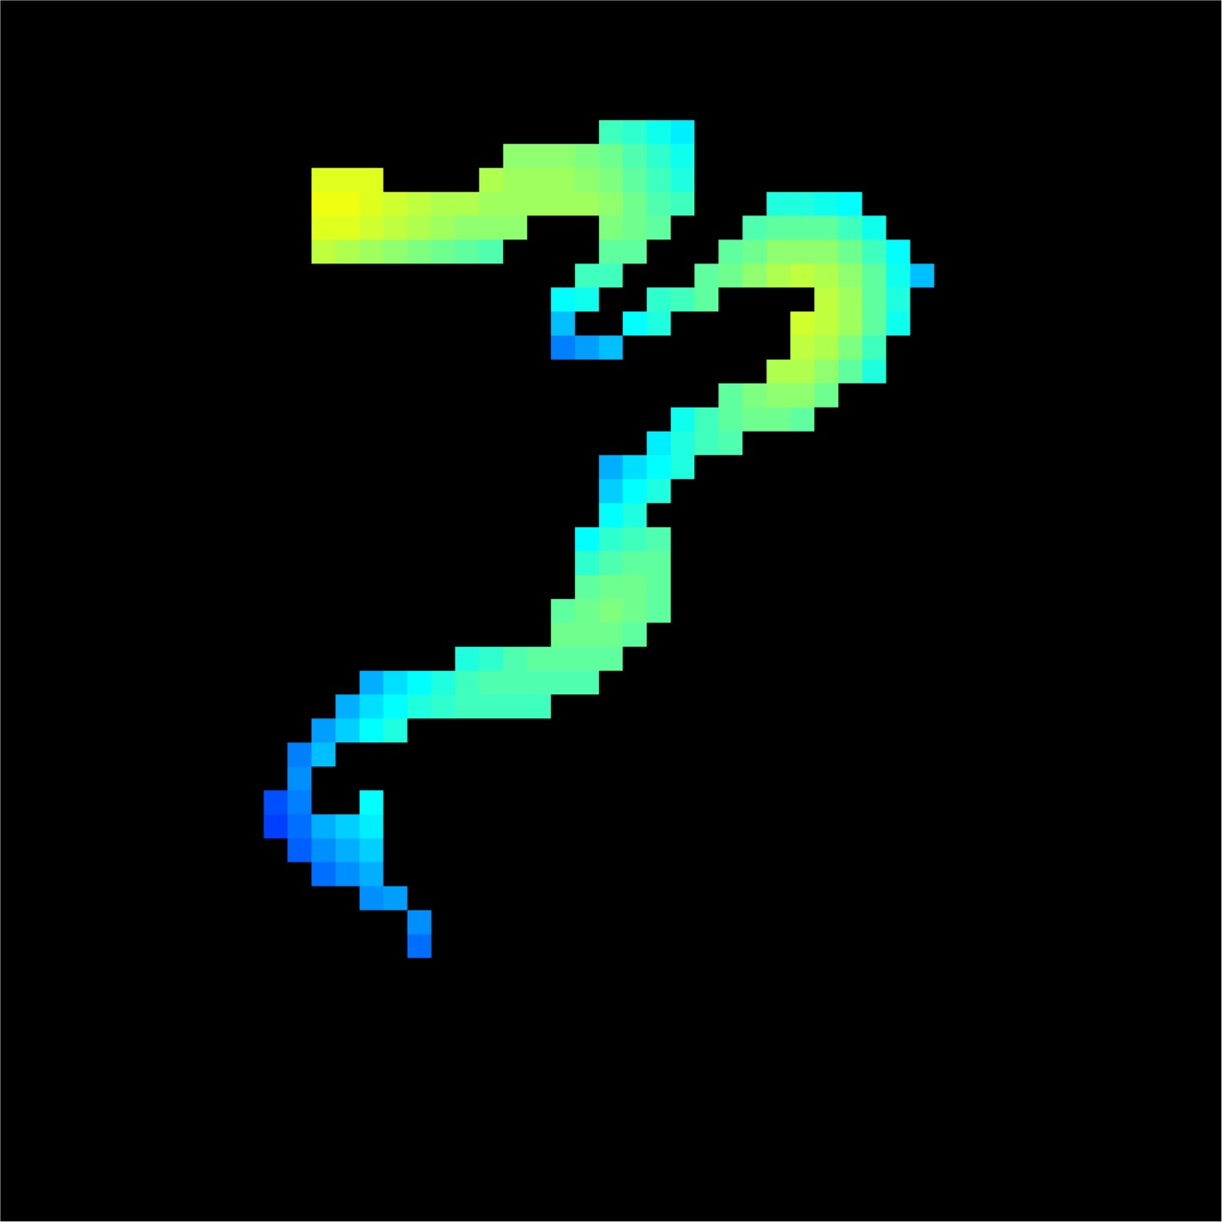
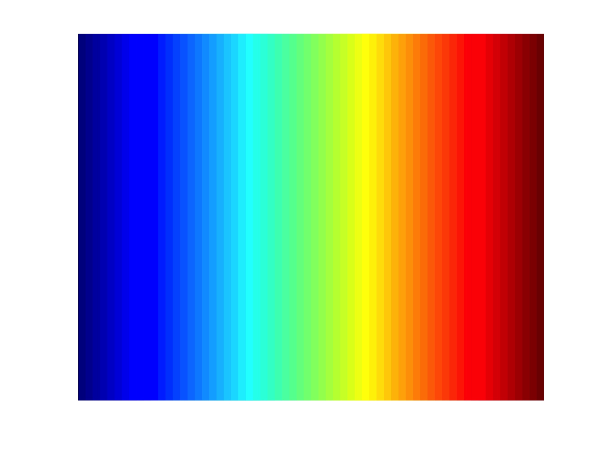
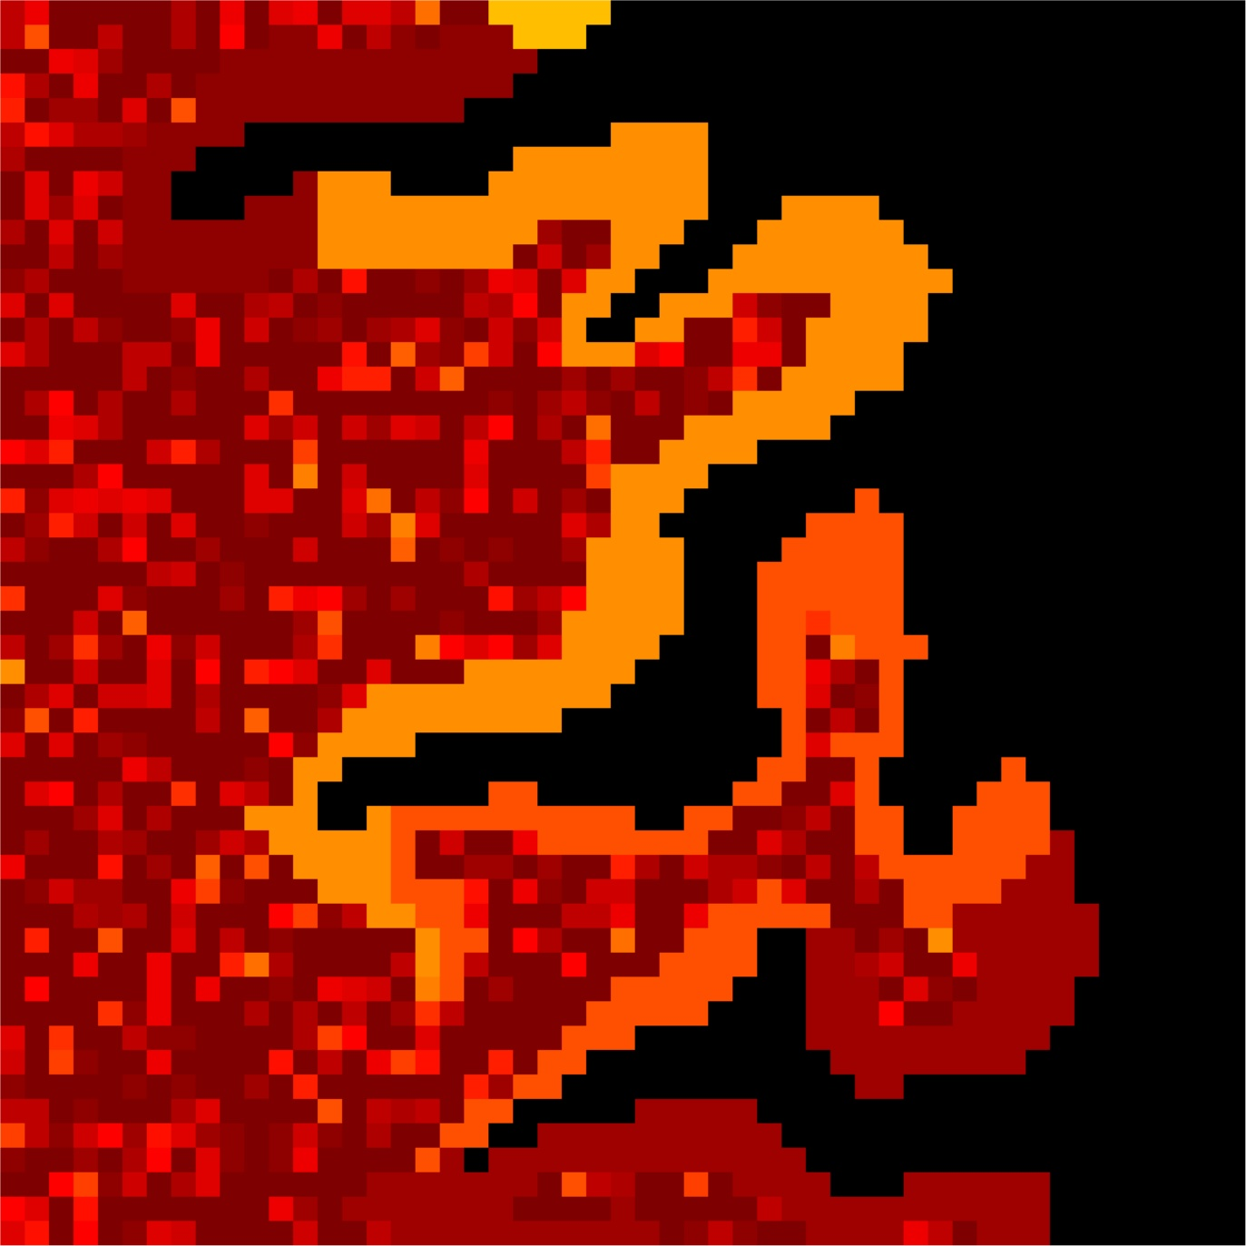
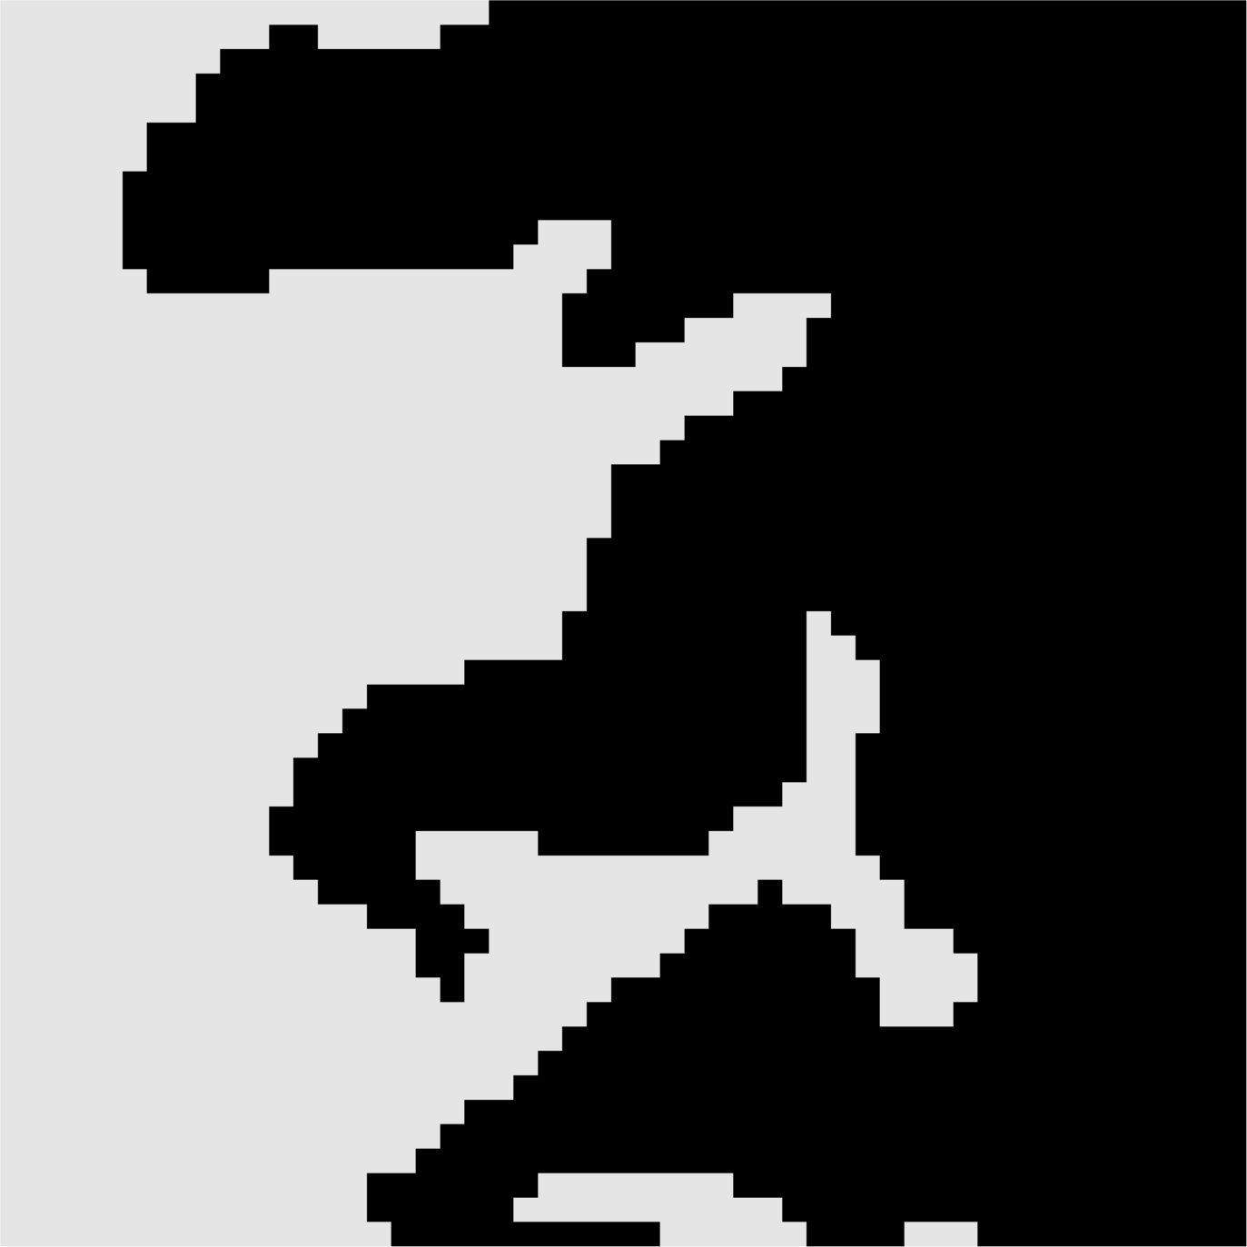
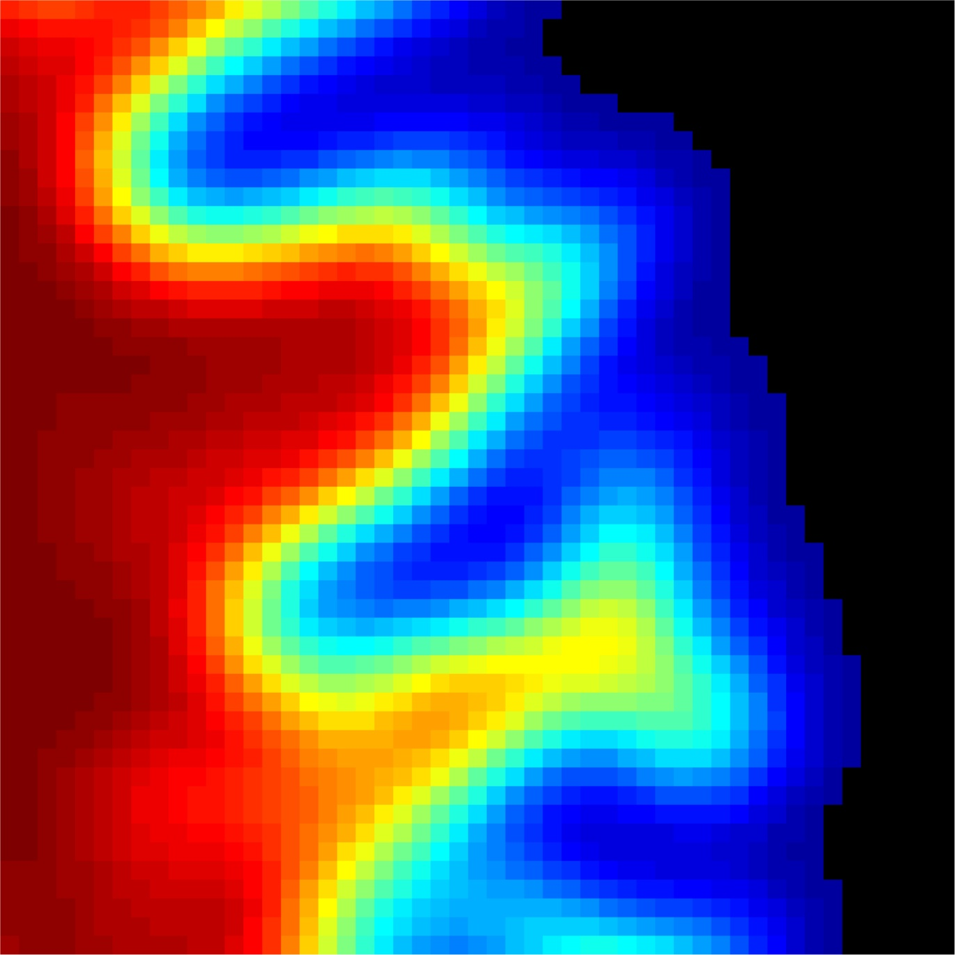
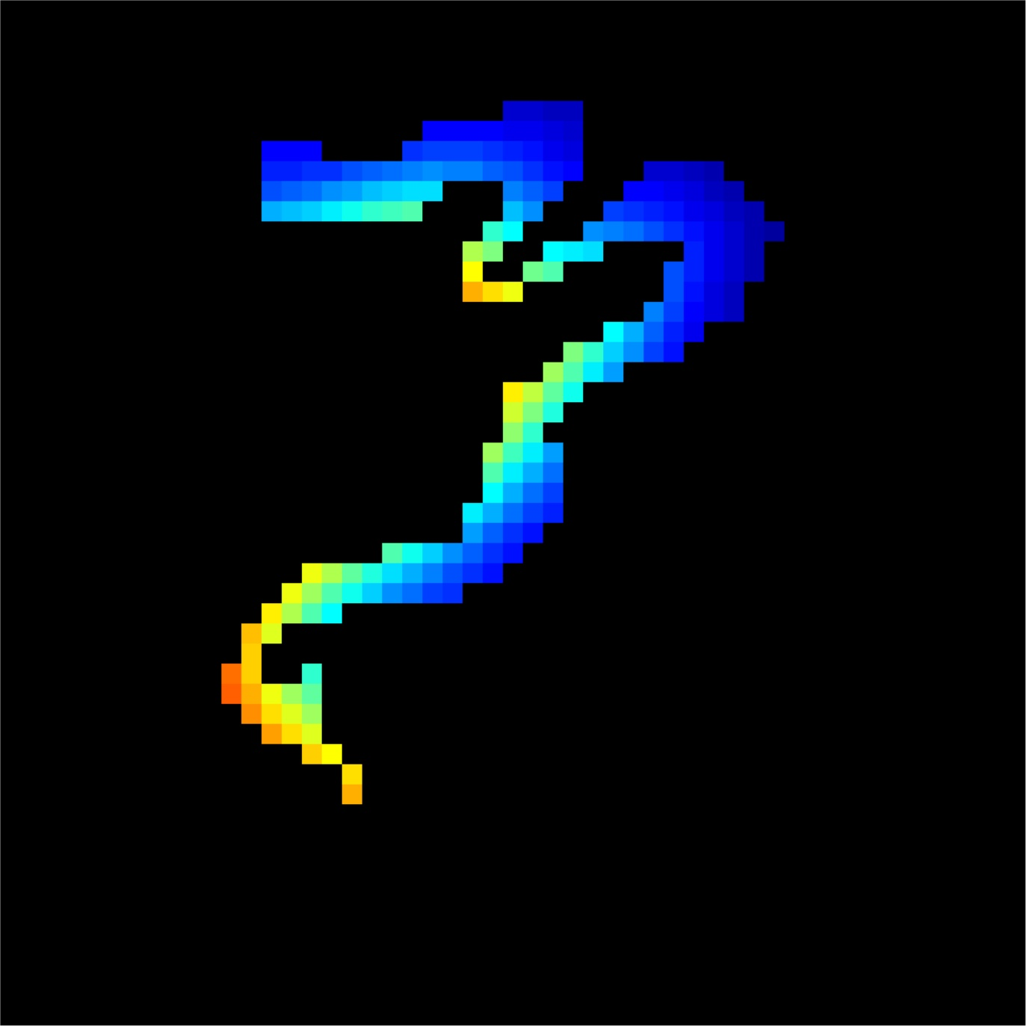
Assumptions made by PVC
3
1
0
0.01

Slide 4
Order of Business
Explain Methods
Results: Fake Data
Results: Tau Data
How to run PVC scripts

Slide 5
Order of Business
Explain Methods
Results: Fake Data
Results: Tau Data
How to run PVC scripts

Slide 6
4 PVC methods
2 compartment (Meltzer)
Gray+white
CSF
3 compartment (Muller Gartner)
Gray
White
CSF
ROI-based (Rousset)
Whatever ROIs you define
Any space left undefined is assumed to have PET signal=0 (CSF)
ROI-based + voxelwise (PARSLR)
Combines Rousset for ROIs you defined with voxel-wise for regions where you did not define an ROI

Slide 7
How does 2 compartment PVC work?
For every voxel in the brain, it figures out what percent signal came from a gray or white matter voxel.
It amplifies the voxel value by dividing it by percent signal
If percent signal from gray or white of voxel is high, it only amplifies it a little
If percent signal from gray or white of voxel is low, it amplifies it by a lot

Slide 8
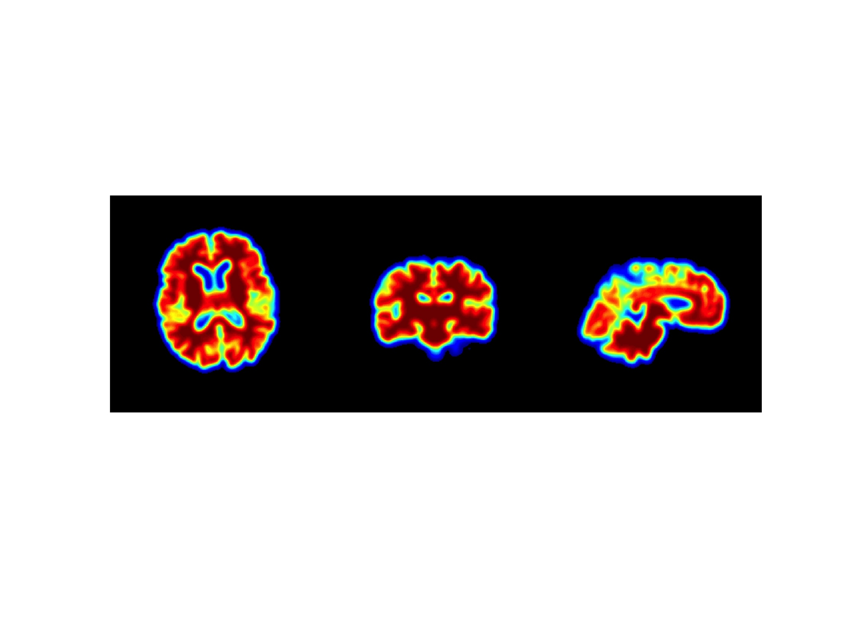
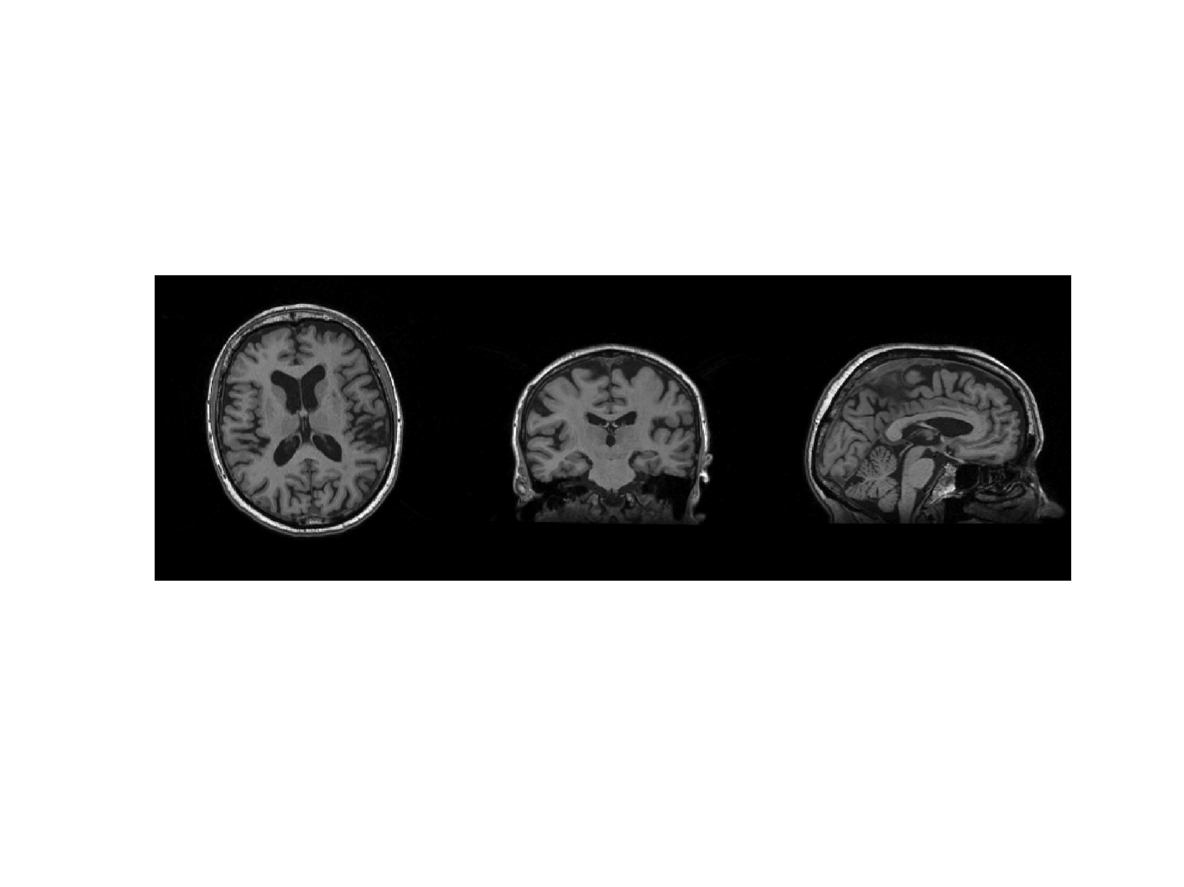
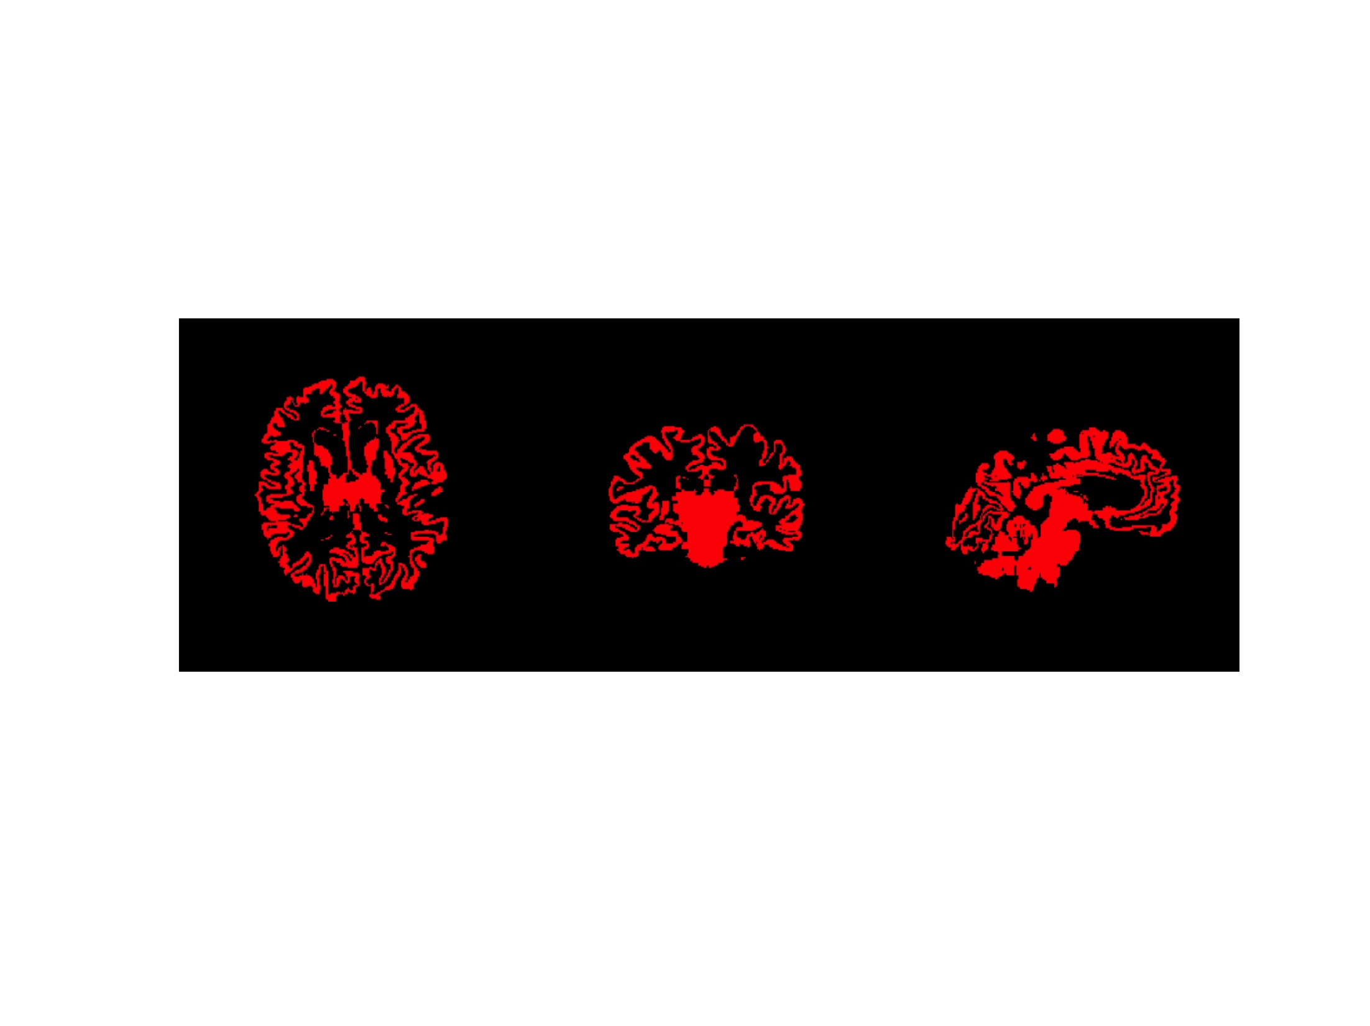
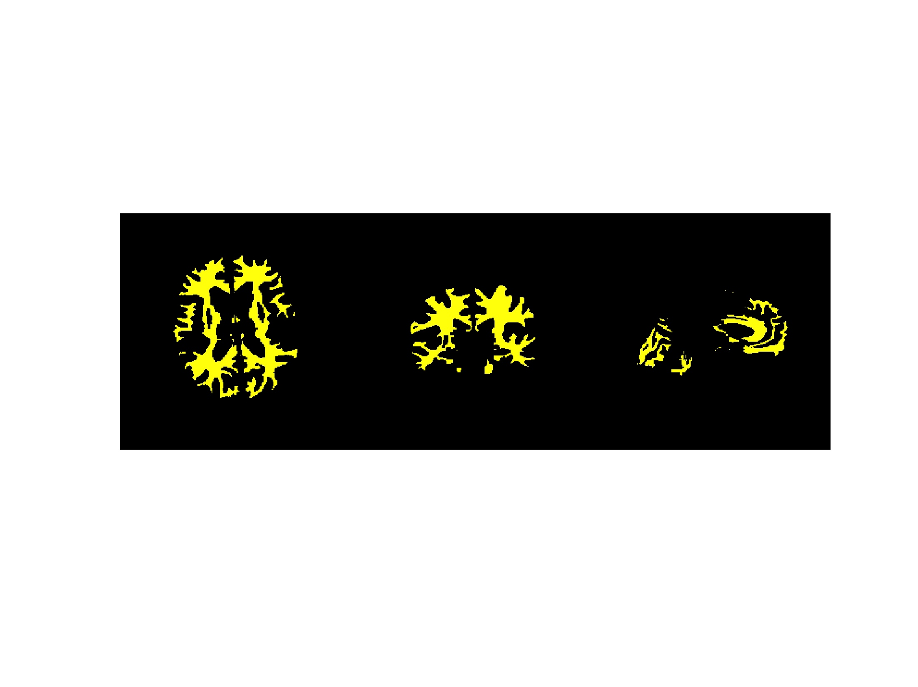

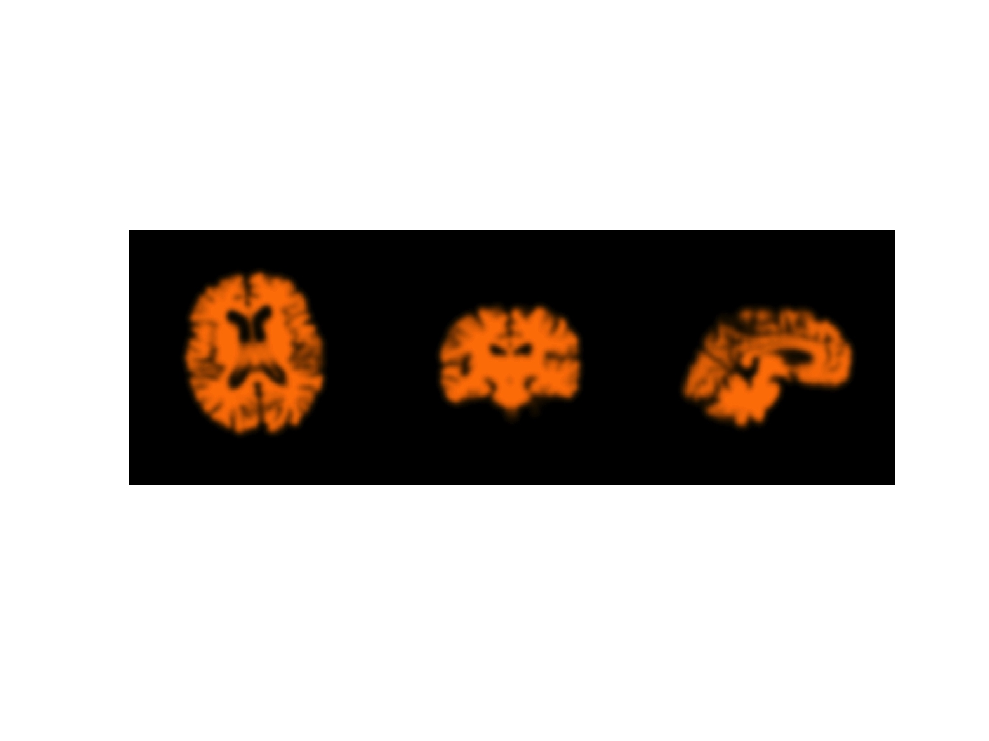
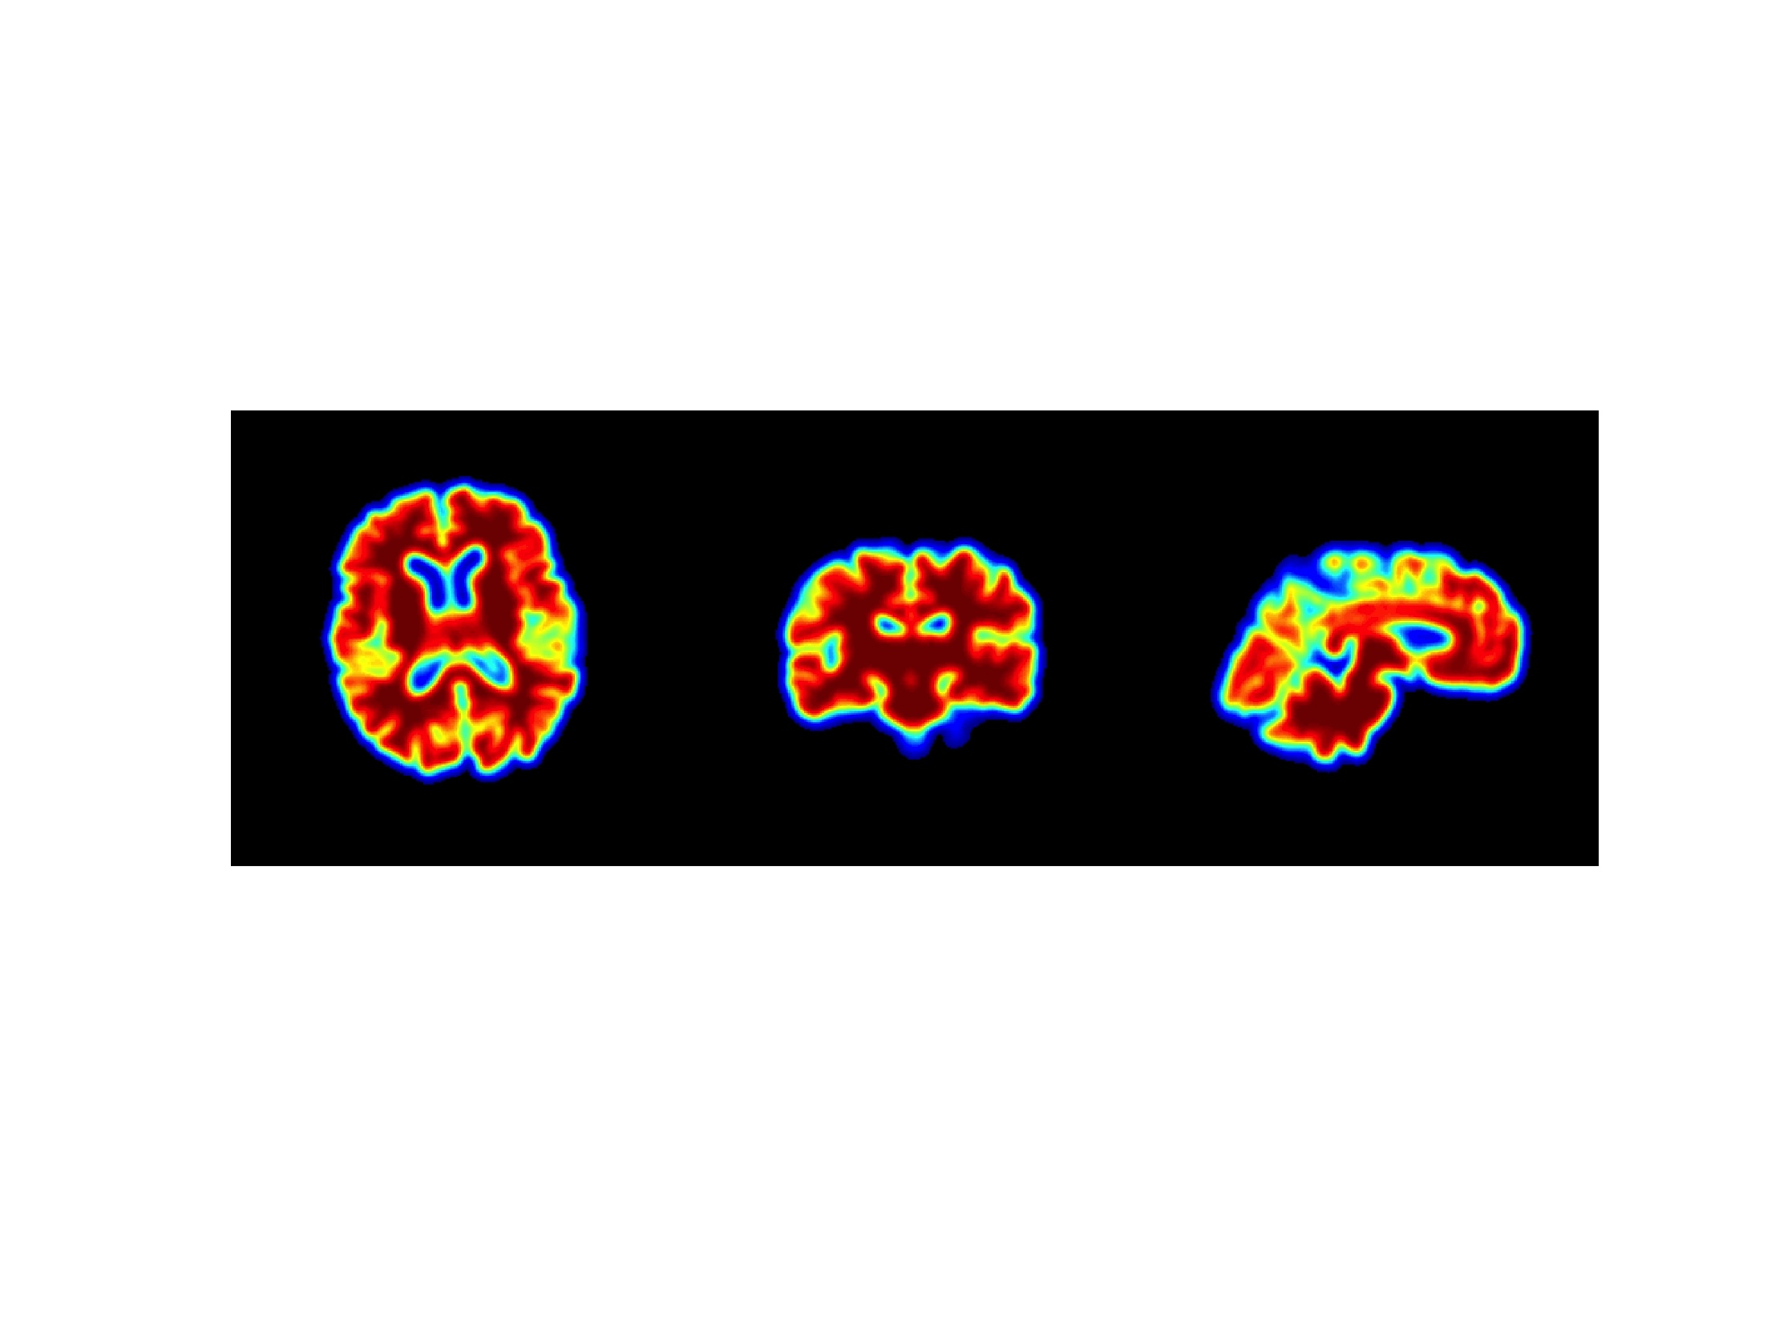
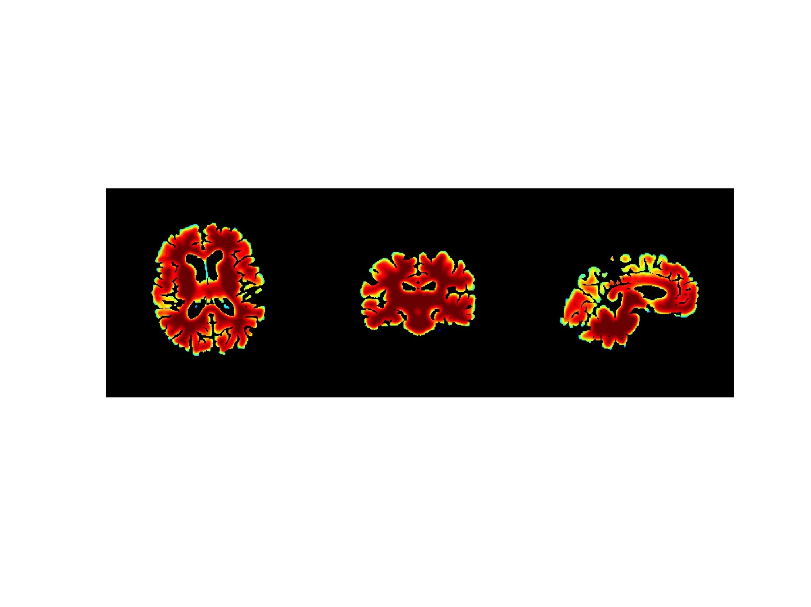

How does 2 compartment PVC work?
PET, gray = white
1. Gray mask
2. White mask
÷
3. Gray+White
4. Smooth
Gray+White
Masked Smoothed Gray+white
5. Mask Smoothed
Gray+White
=
6. PET / Mask
SmoothGray+white
= PVC 2 com-
partment solution
0
1
PVC2 PET

Slide 9
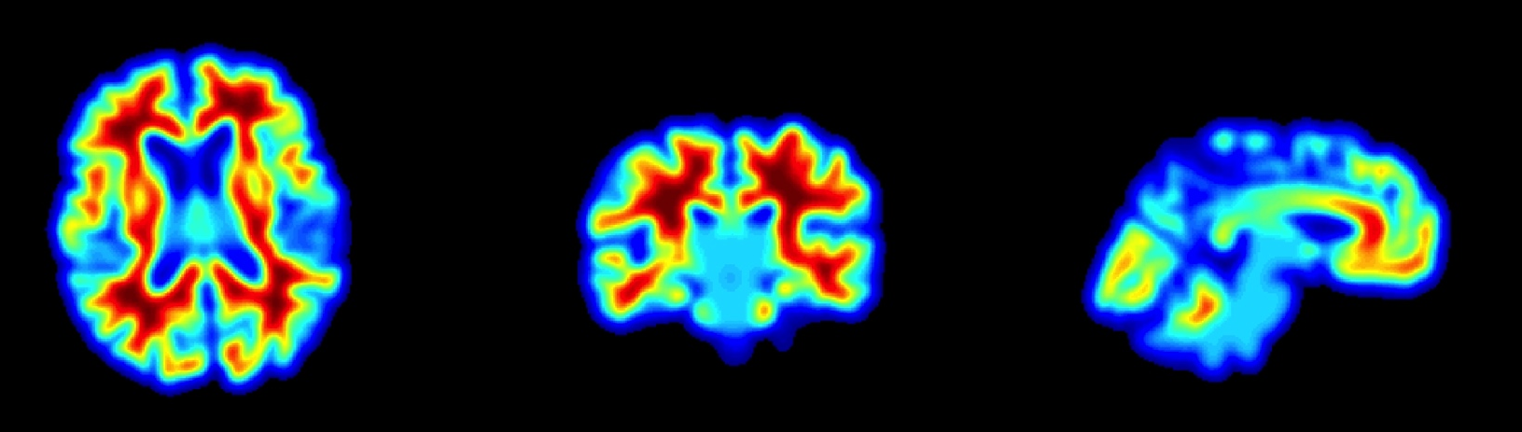
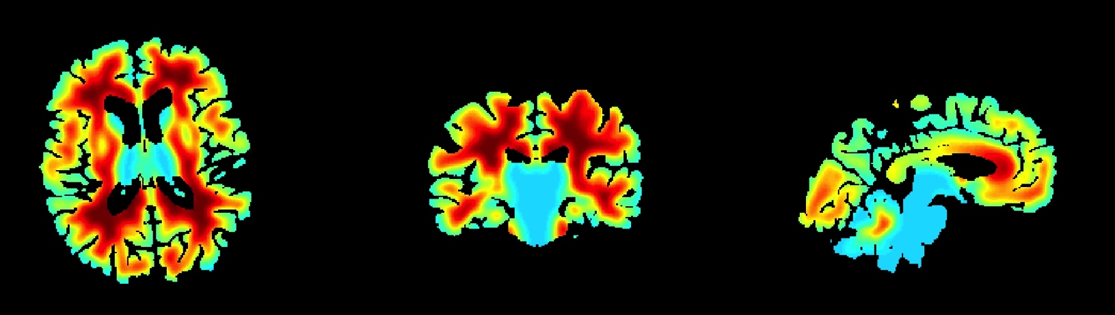
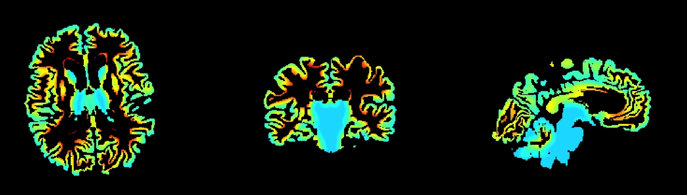
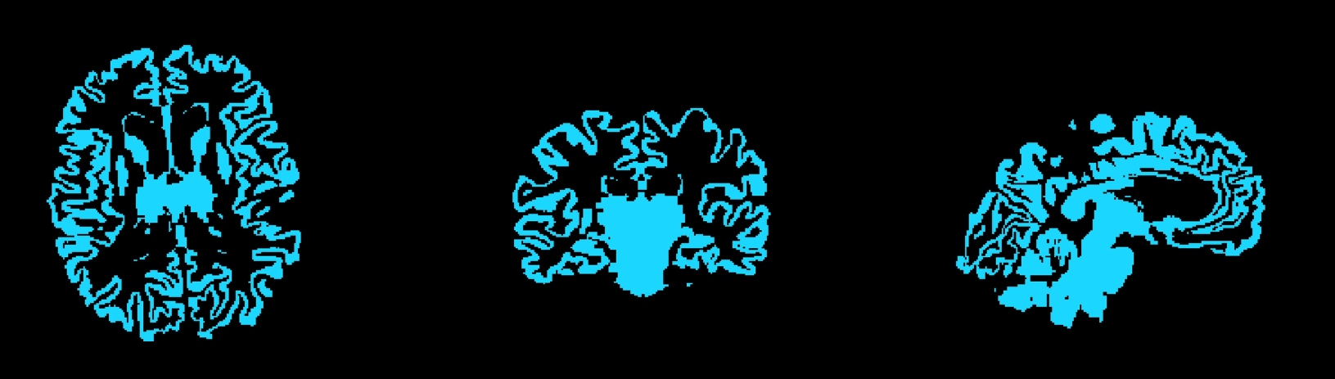
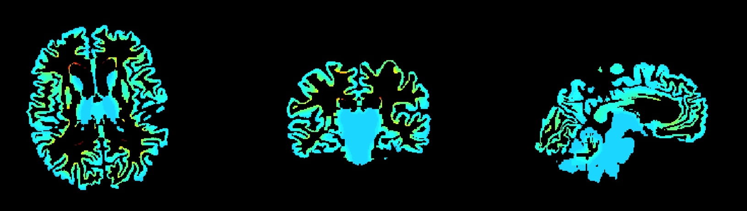
Where does 2 compartment PVC fail ?
PET gray ≠ white
Masked Smoothed Gray+white
=
0
1
PVC 3 compartment
PVC2 PET
Correct Answer
0
3

Slide 10
What we’ve learned thus far…
If Gray = White and Gray = Gray, then 2 compartment works great
2 Compartment only corrects for partial volume due to CSF
If all of Gray is homogenous, and Gray≠White, then 3 compartment almost perfectly recovers original values … WHY almost? … 3 compartment theory …

Slide 11
How does 3 compartment PVC work?
For every voxel in the brain, it figures out what percent signal came from a gray matter and what percent signal came from white matter
Assuming you can estimate the non-PVE value for white matter, you can subtract out the influence of white matter (non-PVE white x percent signal of voxel that came from white matter) from your gray matter voxel
After subtracting out white matter influence, it amplifies the voxel value by dividing it by percent signal of that voxel came from gray matter
If percent signal from gray matter of voxel is high, it only amplifies it a little
If percent signal from gray matter of voxel is low, it amplifies it by a lot

Slide 12
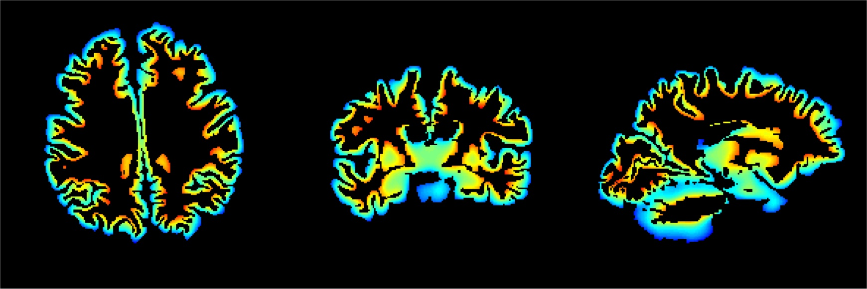
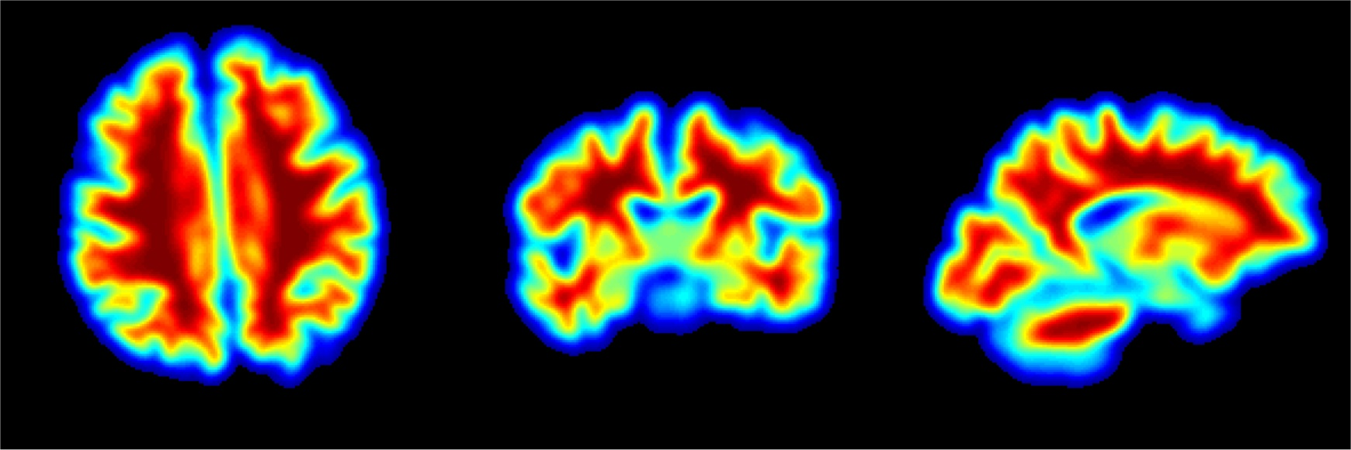
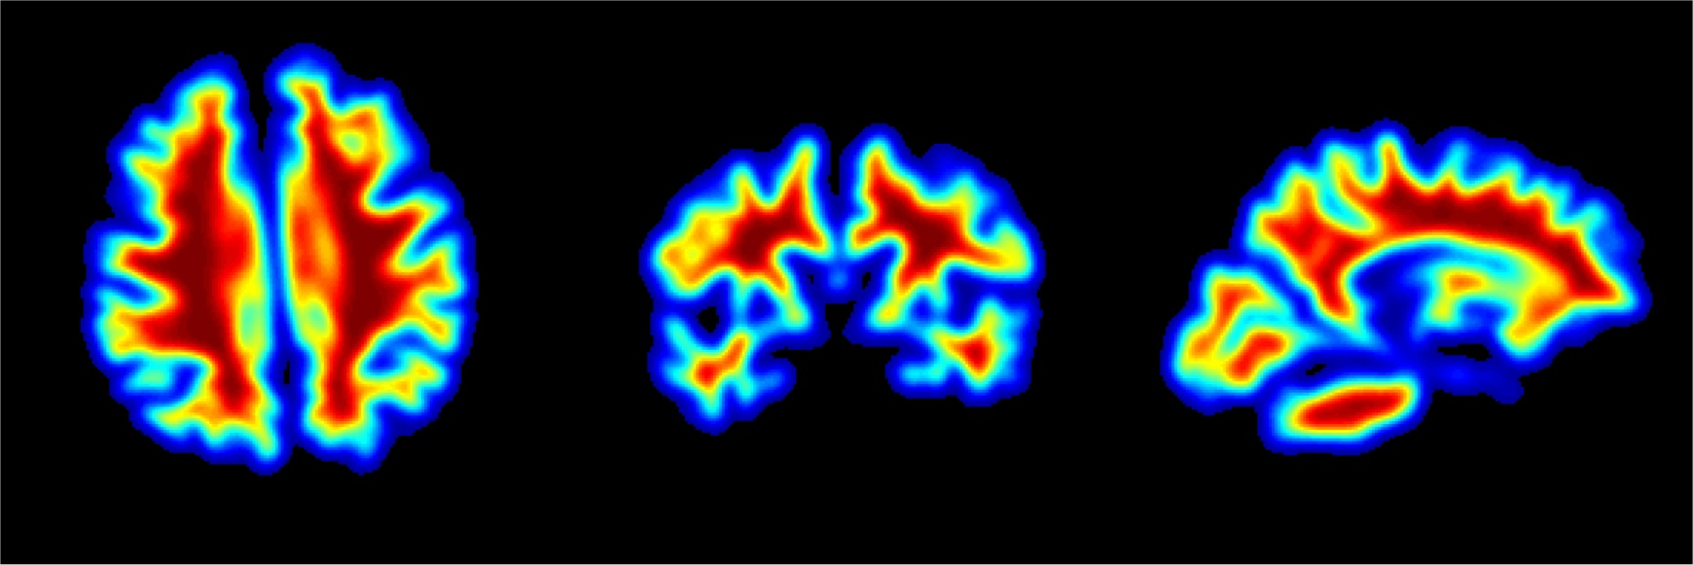
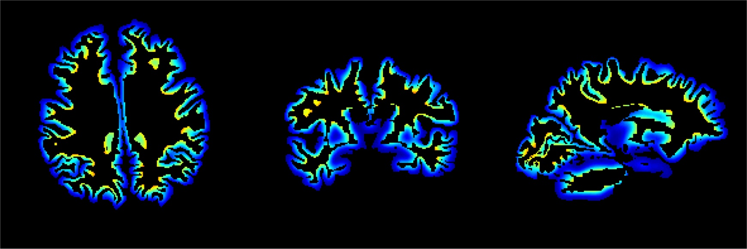
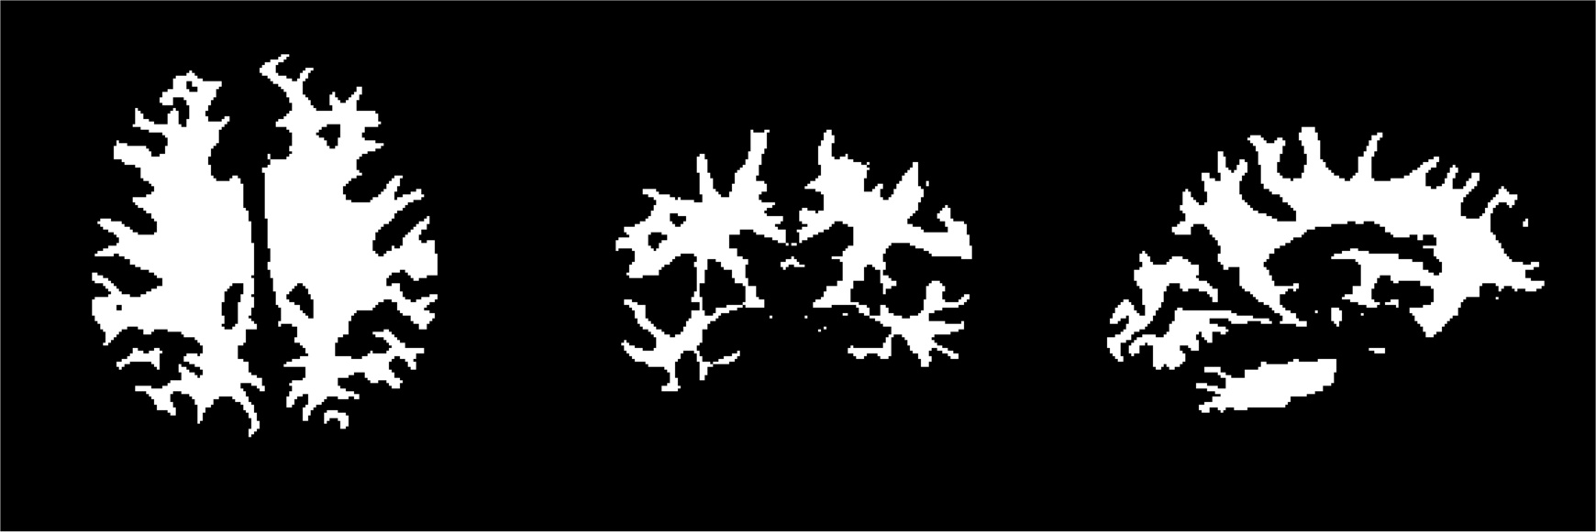
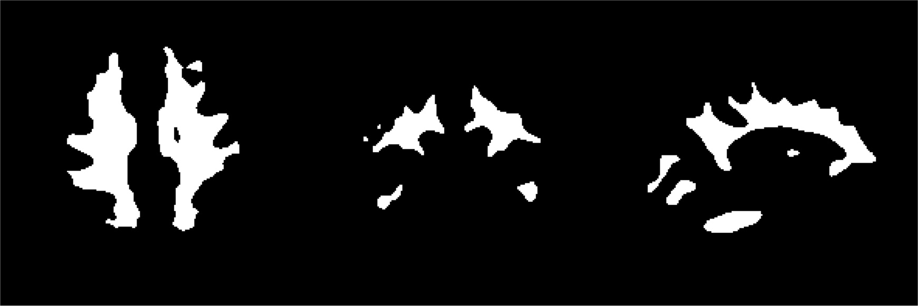
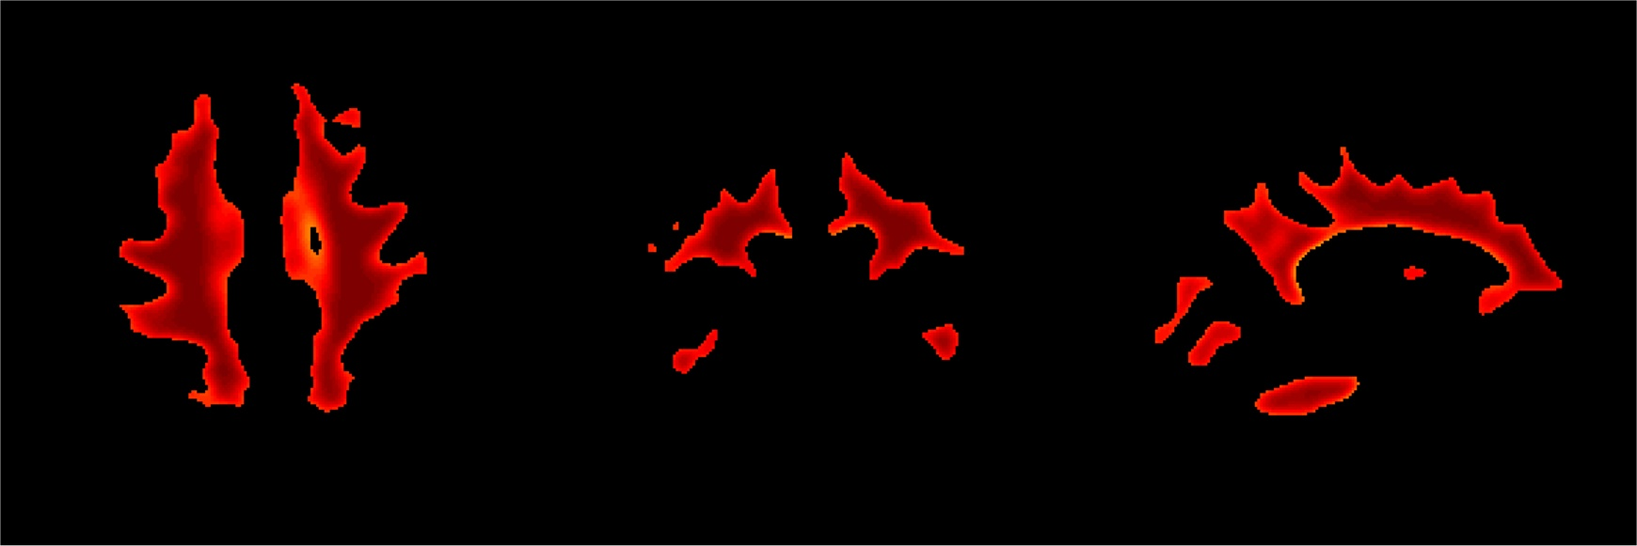
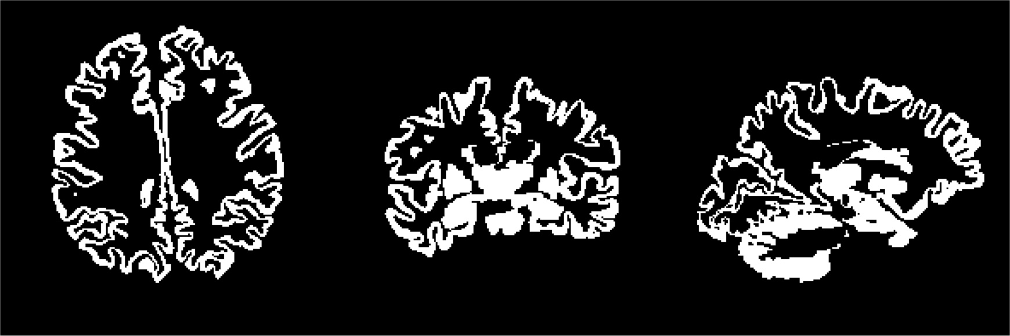
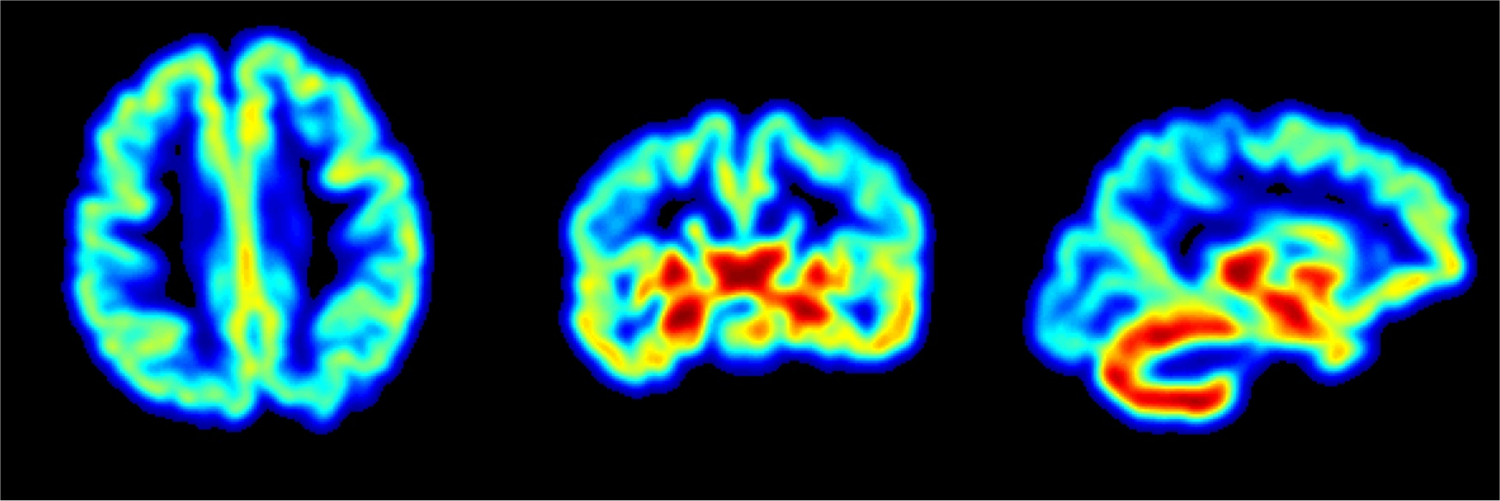
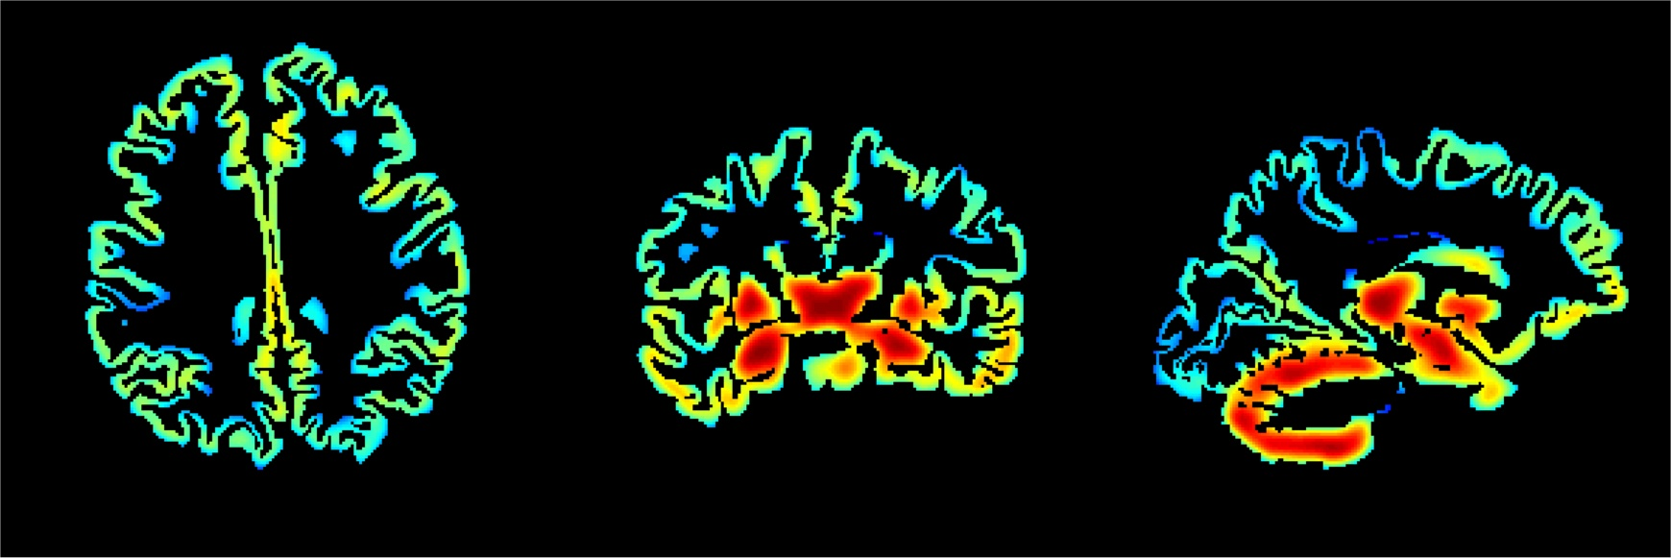
How does 3 compartment PVC work?
-
3
(
)
PET
1. Estimate White matter value
Gray-masked PET
Smooth White matter mask
Apply threshold (here 0.7)
Mask PET image with
voxels > threshold
Calculate mean of masked PET
Image
0
3
1
1
PET where smoothed white mask > 0.7
Smoothed White Matter Mask
Gray-masked Smoothed White Matter
Smoothed White
White Matter Mask
2.7
White Mask > 0.7
÷
2. Subtracting out white from gray
- Go back to smoothed white matter
mask
- Mask everything with gray matter
- Subtract mean white x smoothed
white from PET image
2.7 x
0
(remember its supposed to be 3)
0
0
1
Smoothed Gray Matter Mask
Gray Mask
3. Amp up gray matter signal
intensity
- Take Gray matter mask
- Smooth it
- Mask Smoothed with Gray matter
mask
- Divide (PET-White signal) by this
0
Gray-masked Smoothed White Matter
= PVC 3 compartment

Slide 13
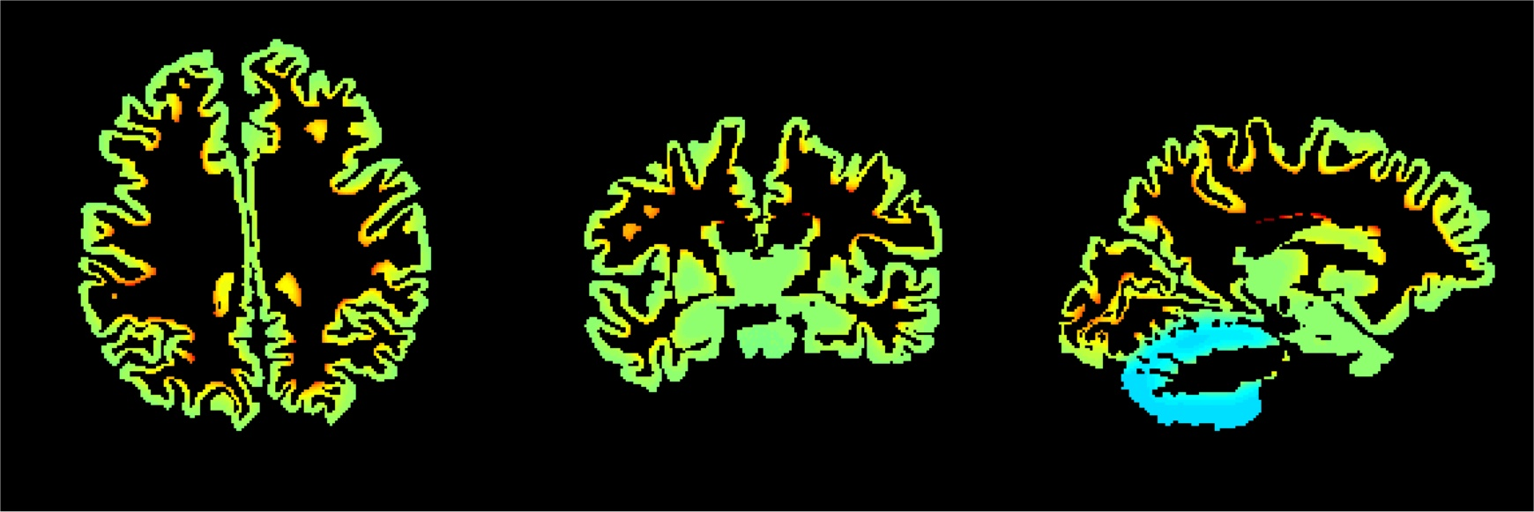
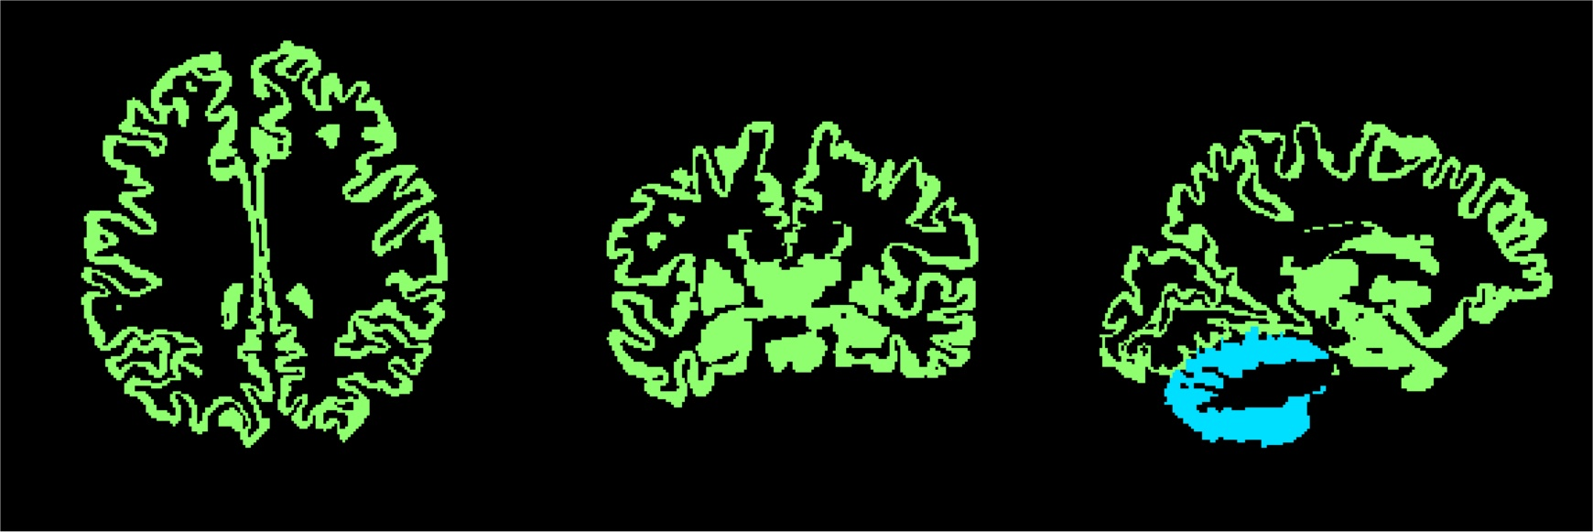
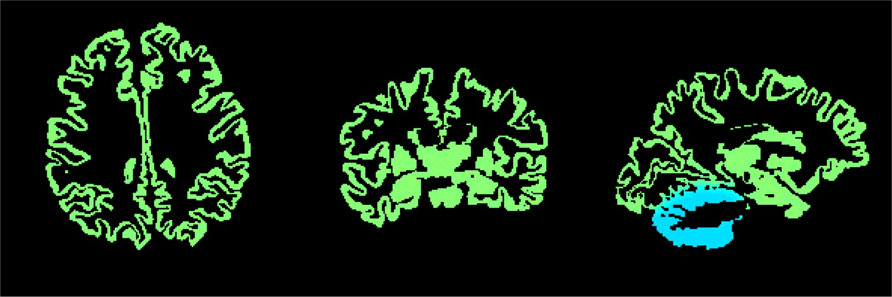
Where does 3 compartment PVC fail ?
Original PET image
PVC3 PET image
White = 2.7
Correct Answer
PVC3 PET image
White = 3

Slide 14
3 compartment theory
Corrects for partial volume effects of CSF and white matter
Does not correct for neighboring ROIs that contribute partial volume effects into a region
You are guessing what the white matter value is, so room for error

Slide 15
Modeled data: Thresholding white matter mask
Threshold | % of total white matter voxels | Mean % error
60% | 61% | -1.5% ± 8.5%
70% | 46% | -1% ± 6.5%
80% | 30% | -0.6% ± 4.2%
90% | 14% | -0.2% ± 2.0%
***Data created using Freesurfer segmentation from older healthy
control. Varied white matter input value, amount of noise in
white matter region and gray matter ROI values.

Slide 16
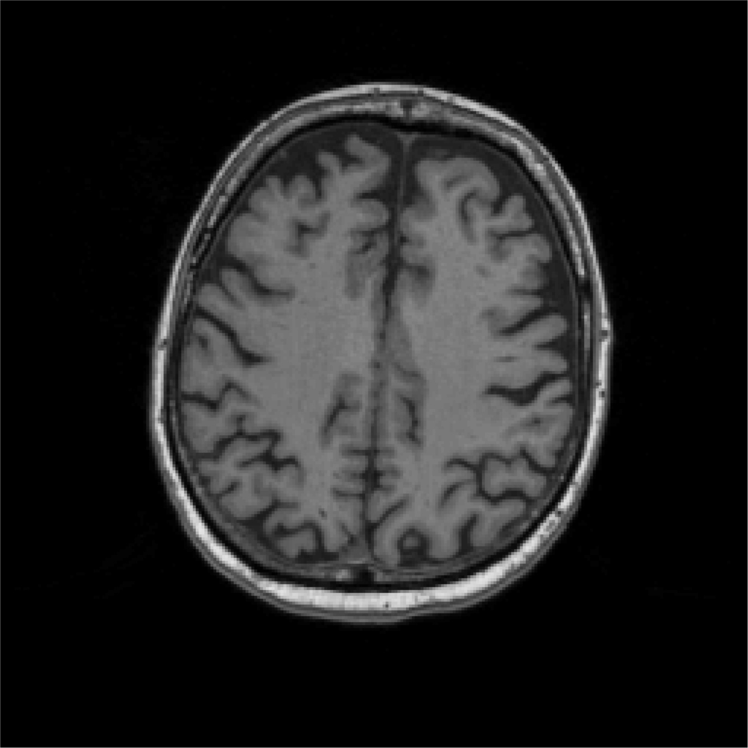
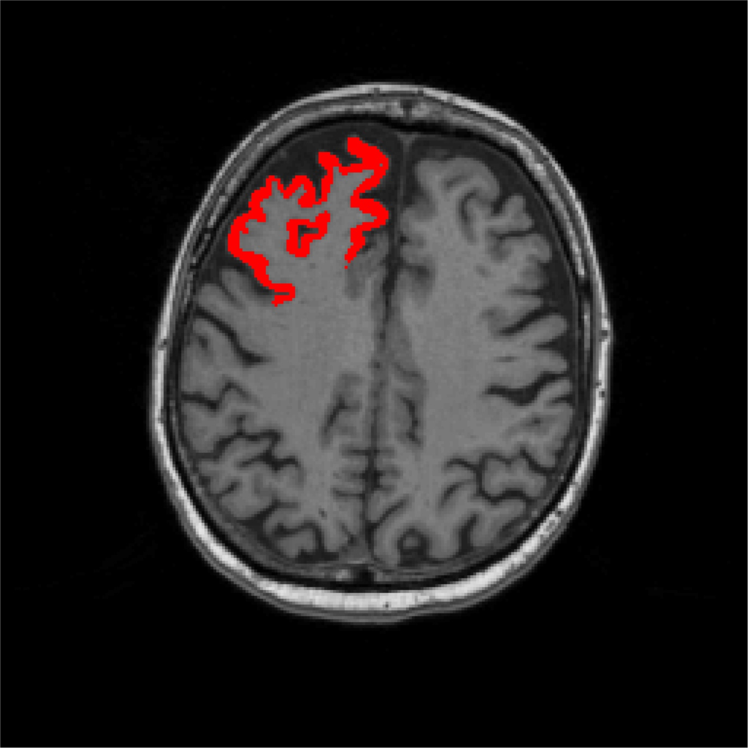
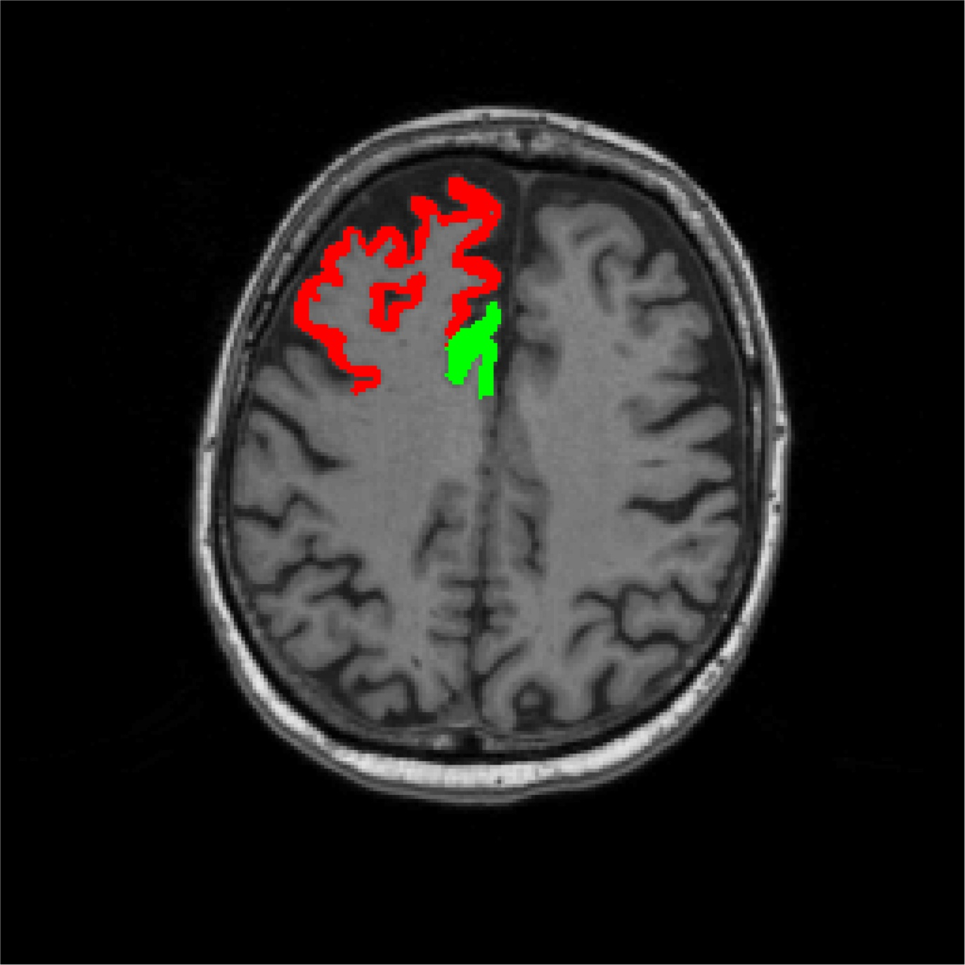
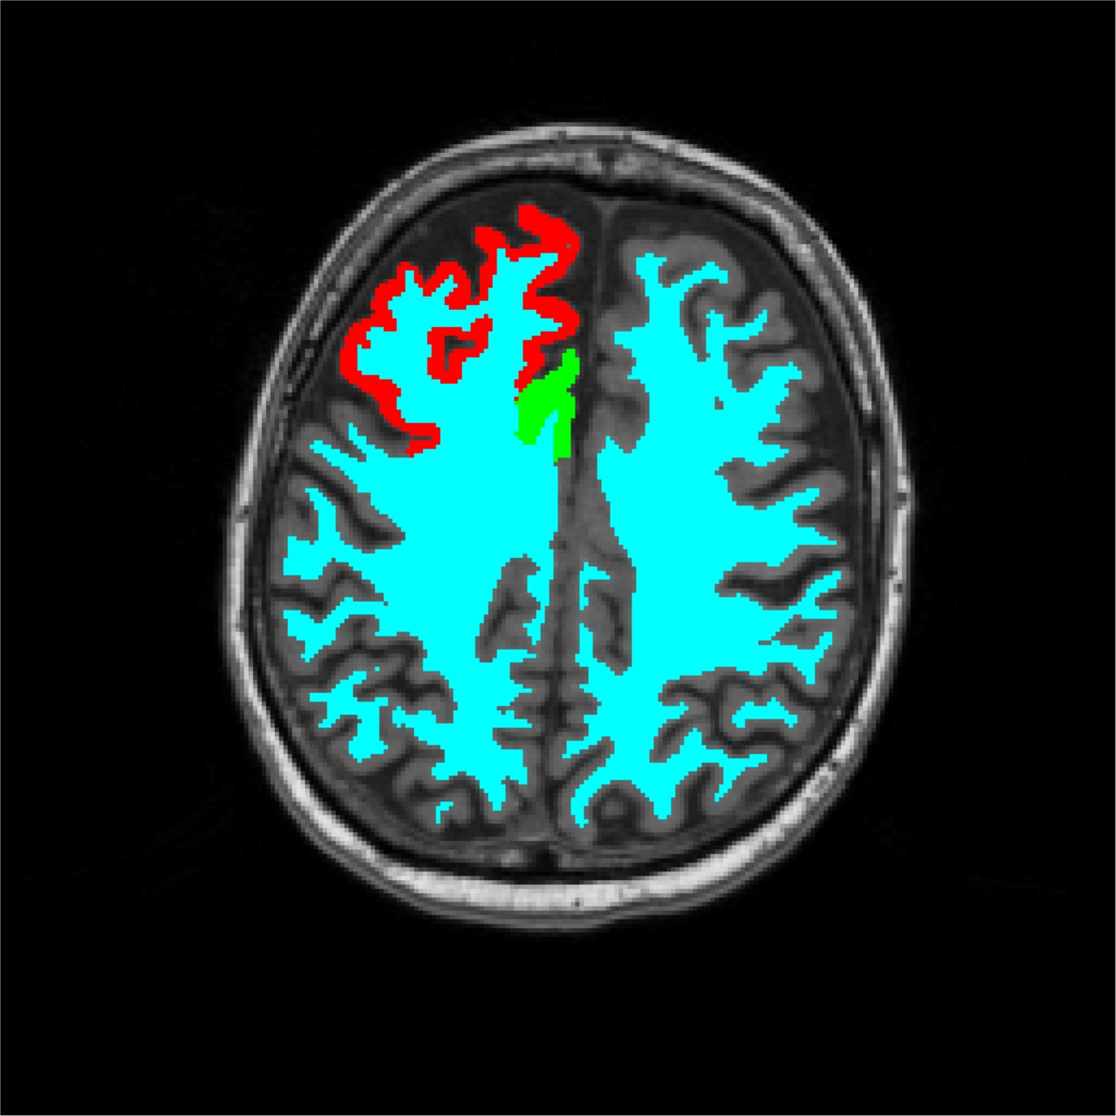







Rousset Method
Signal from itself =
0.436
Signal from neighboring
ROI =0.003
1
Signal from white =
0.244
Signal from neighboring
ROI 2 = 0.019
CSF = 0.293
0
Lfrontal_{PET} = (0.436)Lfrontal_{PVC} + (0.003)Lantcing_{PVC} + (0.244)White_{PVC} + (0.019)OtherCortex_{PVC}

Slide 17
Rousset Method
Lets say you think the PET scan has 5 homogenous regions, therefore 5 ROIs
(roi1, roi2, roi3, roi4, roi5)
Calculate the % signal from from one roi to another (smoothing binary masks)
(example for roi1: %1in1, %2in1, %3in1, %4in1, %5in1)
Calculate the measure PET values in the 5 regions (roi1_{PET}, roi2_{PET}, etc)
roi1_{PET} = %1in1 x roi1_{PVC} + %2in1 x roi2_{PVC} + %3in1 x roi3_{PVC} + %4in1 x roi4_{PVC} + %5in1 x roi5_{PVC}
roi2_{PET} = %1in2 x roi1_{PVC} + %2in2 x roi2_{PVC} + %3in2 x roi3_{PVC} + %4in2 x roi4_{PVC} + %5in2 x roi5_{PVC}
roi3_{PET} = %1in3 x roi1_{PVC} + %2in3 x roi2_{PVC} + %3in3 x roi3_{PVC} + %4in3 x roi4_{PVC} + %5in3 x roi5_{PVC}
roi4_{PET} = %1in4 x roi1_{PVC} + %2in4 x roi2_{PVC} + %3in4 x roi3_{PVC} + %4in4 x roi4_{PVC} + %5in4 x roi5_{PVC}
roi5_{PET} = %1in5 x roi1_{PVC} + %2in5 x roi2_{PVC} + %3in5 x roi3_{PVC} + %4in5 x roi4_{PVC} + %5in6 x roi5_{PVC}

Slide 18
Rousset Method
In this example, 5 equations and 5 unknowns, solve minimizing the error
Solution depends on ROIs
As you increase number of ROIs, the least squared problems becomes more and more ill-conditioned

Slide 19



What is happening in your favorite ROI?
Amount from Other
Entorhinal Cortex
0.20
Occipital Cortex
0.05
Parietal Cortex
0.03
Frontal Cortex
0.02
Temporal Cortex
0.10
Anterior Cingulate
0.12
Precuneus
0.08
Posterior Cingulate
0.11
Caudate
0.09
Hippocampus
0.24
Pallidum
0.25
Putamen
0.14
Thalamus
0.16
Cerebellar Gray
0.03
Brainstem
0.06
% signal from itself
, CSF
, White Matter

Slide 20
PARSLR Method
Combines ROI-based and voxelwise PVC-ing.
Does not require complete and accurate segmentation. Define ROIs you feel confident about, all else will be solved voxelwise.
Process is iterative
code guesses initial PVC values in image (both ROI and voxelwise)
smooths image
calculates error
updates guess to PVC value… repeat
you can decide number of iterations.
Its slow (depends on number of ROIs/voxels and number of iterations).
Code runs analyze format images. I can only get it to work for 1 image at a time.

Slide 21
Resolution of scanner
Biograph 4mm smooth (calculated using Hoffman)
6.5 x 6.5 x 7.25mm
Biograph 4mm smooth (estimated from 2014 paper)
7.1mm in center, 7.7mm at 8cm peripheral to center
Biograph 0mm smooth (calculated using Hoffman)
5.5 x 5.5 x 5.25 mm
Biograph 0mm smooth (from 2014 paper)
5.83mm in center, 6.61mm at 8cm peripheral to center
HR 4mm smooth
7 x 7 x 7.5mm
HR 0mm smooth
5.67 x 5.67 x 6.42mm

Slide 22
Order of Business
Explain Methods
Results: Fake Data
Results: Tau Data
How to run PVC scripts

Slide 23






Methods for testing
Using a subject’s MRI scan, segmented using Freesurfer
Simple
Complicated
Simple Model :
Cerebellar Gray = 1
Brain1: white = 1 & all else = 1
(so frontal=hippocampus=temporal)
Brain2: white = 1 & all else = 1.5
Brain3: white = 1 & all else = 2
Continue cycling through 1-3 (by
0.5 intervals) until I have Brain25
Complicated Model
Cerebellar Gray = 1
Brain1: white = 1+noise & all else = randomly assigned values from 1-3.5, so ROIs have different values, but values are homogenous within ROI
Continue cycling through white matter values creating 375 possible brains

Slide 24





PVC 2 compartment results
Simple Model Results
Complicated Model Results
Why is the correction not perfect when gray = gray = white ??
**Due to Normalization by Cerebellar Gray & effect of Cerebellar White

Slide 25


PVC 3 compartment results
Complicated Model Results
Simple Model Results
** Almost perfect. Why is it not perfect ??
Due to white matter estimation

Slide 26


Rousset results
Complicated Model Results
Simple Model Results
** Almost perfect. Why is it not perfect ??
Small ROIs used to create PET scan-like image, big ROIs used in Rousset PVC.

Slide 27
Order of Business
Explain Methods
Results: Fake Data
Results: Tau Data
How to run PVC scripts

Slide 28




PVC on Tau Data: TACs
Cerebellar Gray Temporal Cortex
Hippocampus
Thalamus

Slide 29




PVC on Tau Data: SUVR
Temporal Cortex
Hippocampus
Thalamus

Slide 30

PVC on Tau Data: DVR & SUVR

Slide 31

PVC on Tau Data: DVR & SUVR

Slide 32

PVC on Tau Data: DVR & SUVR

Slide 33
Order of Business
Explain Methods
Results: Fake Data
Results: Tau Data
How to run PVC scripts

Slide 34
How to run 2 compartment PVC
Code is in
~slbaker/Code/pvc/Apply_Meltzer_PVC_2compartment.m
This is a function, to run it you would type:
Apply_Meltzer_PVC_2compartment(apet,agray,awhite,smooth)
Inputs: apet: path to 1 or multiple PET scans (same subject)
agray: gray matter mask filename
awhite: white matter mask filename
smooth: resolution of scanner, Biograph is 6.5x6.5x7.25
Output: This function creates a new image file in same directory as PET image, with pvcMeltz2_ in front of original pet filename.

Slide 35
How to run 3 compartment PVC
Figure out white matter values
~slbaker/Code/pvc/WhatIsMyWhite.m -or-
~slbaker/Code/pvc/WhatIsMyWhite_aparc.m
Input is pet image, white mask or aparc+aseg, and scanner resolution
Output is thresholds from 0.01 to 1, and corresponding mean, standard deviation and mask size … you decide your threshold
Run Partial Volume 3 compartment Code:
~slbaker/Code/pvc/Apply_MG_PVC_3compartment.m
Ex: Apply_MG_PVC_3compartment(apet, agray, awhite, 3,[6.5 6.5 7.25])
Inputs: pet filename, gray mask filename, white mask filename, white matter estimate (single number), scanner resolution (3 numbers)
Outputs: writes out image

Slide 36
How to Rousset ROI-based PVC
Define ROI groups from aparc+aseg.m
~slbaker/Code/pvc/CreateROIgroups_for_RoussetPVC.m
Copy file to you directory and edit as you see fit.
Make sure an ROI is not assigned to more than one group. Any space in image that isn’t defined as an ROI is assumed to be CSF and have a value = 0.
Output variable is roigroups, where the size of this variable = number of ROIs you are submitting to Rousset PCV.
Run Rousset ROI-based PVC Code:
~slbaker/Code/pvc/Apply_Rousset_PVC.m
Ex: Apply_Rousset_PVC(apet, aaparc, roigroups, 3,[6.5 6.5 7.25])
Inputs: pet filename, aparc+aseg filename, variable roigroups, scanner resolution (3 numbers)
Outputs: roigroups with original and PVC corrected values for each ROI

Slide 37
How to run: PARSLR Method
Code is in ~slbaker/Code/pvc/parslr.m
[roi kl] = parslr(‘/home/jagust/slbaker/pet.img’, ‘/home/jagust/slbaker/masks.img’,100)
INPUTS:
Single PET image in analyze format
Single mask image in analyze format (similar to aparc+aseg, all voxels in an ROI assigned same integer, each ROI as its own integer, any voxels with value 0 are solved voxelwise
Number of iterations, default is 100
Vector frames: which frames you want to analyze
Smoothing kernel. I have set this to the Biograph smoothing kernel
OUTPUTS:
Writes image
roi is 3d array of concentrations at each iteration for each ROI
kl – Kullback-Leibler divergence values (goodness of fit measure)

Slide 38
The End.
Thanks:
Michael
Vyoma

Slide 39


